Slide 1
Education

Slide 2
Contents
Scenarios
Attendance Management Easy management and reporting of student attendance
Academics Assistant One Hub for students to manage their day
Event Finder Discover events, workshops in campus and participate effortlessly
For each scenario:
Scenario Vision
Primary Persona
Scenario Storyboard
Solution Design Best Practices
Solution Architecture

Slide 3
Attendance Management
Education Book of Dreams

Slide 4


Scenario Vision
Teacher
Context
Sandra is a History teacher at Contoso schools and is responsible for handling 5 different classes at different levels. She has at least 2 lectures per day to deliver
One of the routine activities that Sandra is required to perform is record attendance of students in her class. She does it via a roll call at beginning of class, aggregating it at end of her day for reporting to a central record register
Current State
Sandra starts her day by going through her calendar and identifying the classes and lectures she has to deliver.
Once she starts the class delivery, she performs a roll call of student names from the list she maintains of class members for classes she teaches
The students reply one by one during the roll call and this typically takes 5- 10 minutes to complete accurately.
It is also difficult to determine if the students are actively listening to the class after the attendance roll call is complete. This used to be simpler when Sandra had in-person classes
Students who are unable to attend classes intimated the same to their teachers and the administration through emails.
The administrator approves the leave requests of students and proceeds to inform the same to the concerned teacher over email.
At the end of day, Sandra compiles reports manually across all of her classes and emails before uploading it in the database
Future State
Sandra gets to see her list of classes and reminder from the Teams app on upcoming class for her to confirm
The app provides an attendance code that Sandra can flash at any time during the class for students to view and enter in their app
During the class, students are prompted to enter their attendance code automatically. Along with code, the app also allows Sandra to ask an optional question that gives a hint to student's attentiveness in class content
As the class ends, attendance report is compiled automatically by the app and is available for Sandra to view in a dashboard fashion.
The attendance report can also be downloaded as an excel file for Sandra to perform any further analysis
Students are provided with friendly options to submit their leave requests to the school administrators
The students and teacher get a real time view of leave requests getting accepted by the administrator.
- Points of Friction

Slide 5

Sandra Jones, History Teacher
Sandra is a history teacher who recently started offering her classes virtually over Teams. She is not particularly tech savvy and likes to use apps with simple, non-intrusive user experience to manage her day to day classroom activities

Slide 6
Sandra delivers her class on Teams meeting and she wants to easily handle tracking attendance without disrupting the class and wasting class time

Slide 7
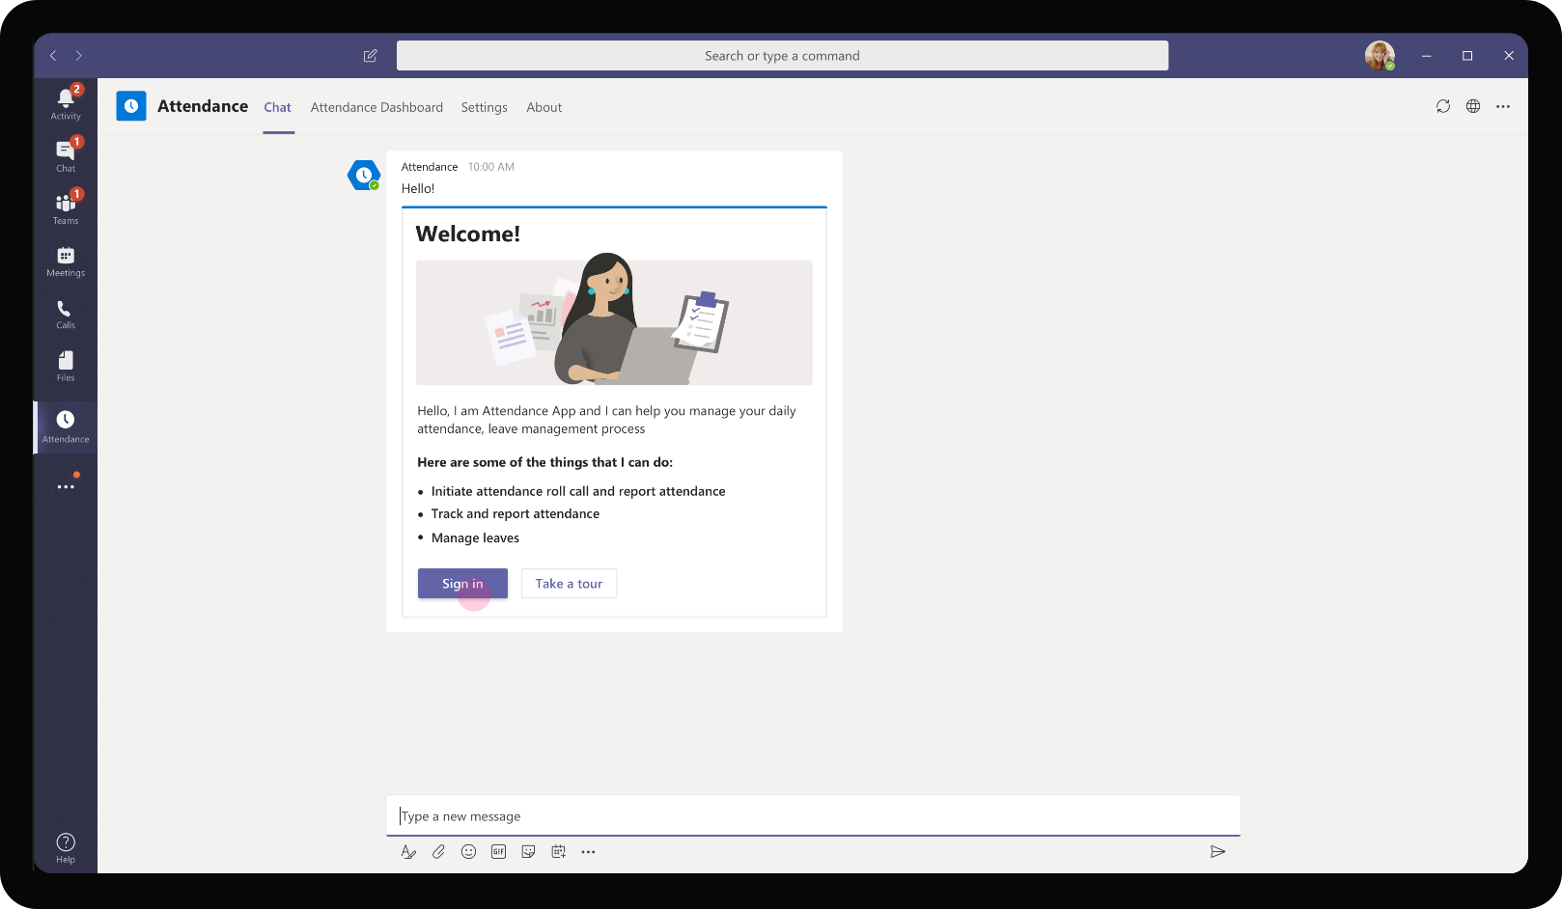
Education – Attendance Management
The app sends a welcome message on installation of the app introducing the features of the app. Sandra signs in using the welcome card.

Slide 8
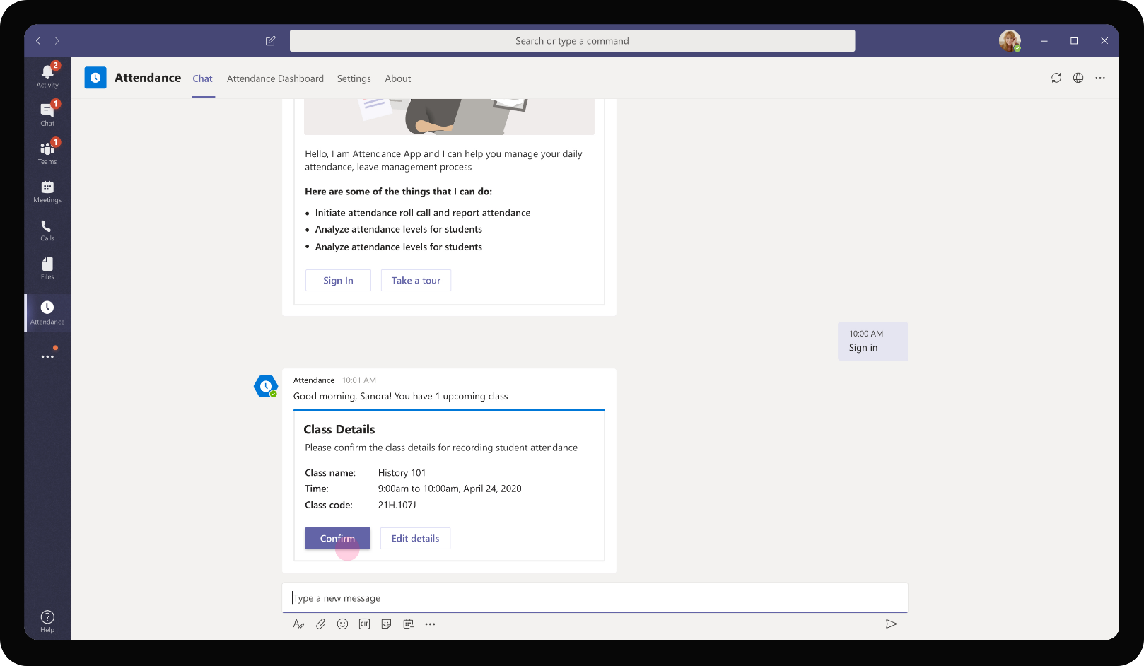
Education – Attendance Management
After signing in, the app sends a card with upcoming class details, fetched automatically from Sandra’s calendar. Sandra may choose to confirm the class information or update details such as time, date, duration in case of changes in class schedule.

Slide 9
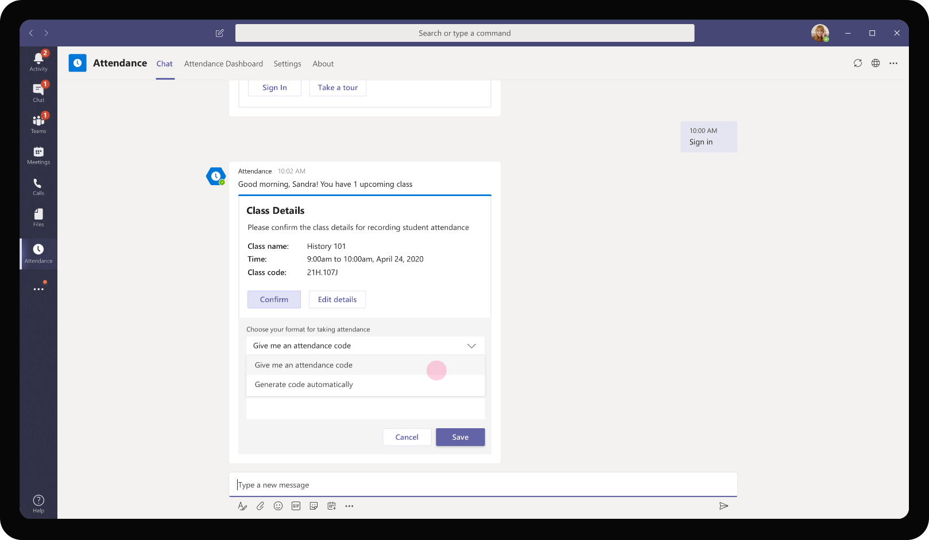
Education – Attendance Management
As Sandra confirms the class, the app provides a couple of options for Sandra to choose from to generate attendance code. This unique code will be shared during class for the students to key in marking their attendance

Slide 10

Education – Attendance Management
Optionally, Sandra may also choose to ask a simple question to students in the class to capture student’s answer along with attendance code. This question could be on the day’s topic to check student’s attentiveness in the online class.

Slide 11
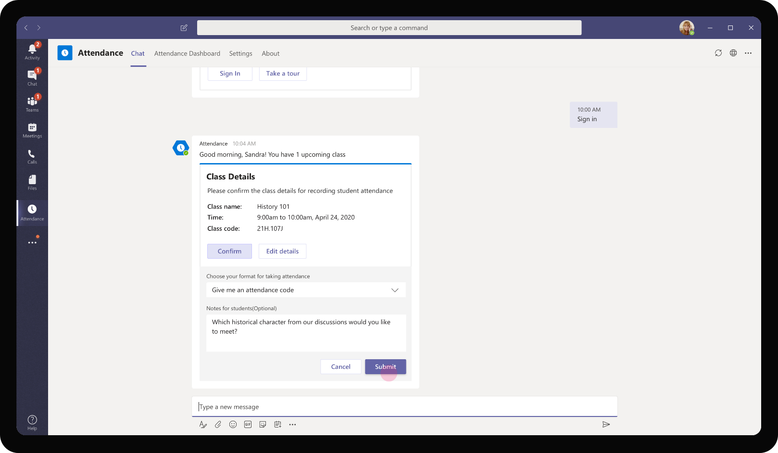
Education – Attendance Management
Sandra chooses to ask a question relevant to the day’s class but which might have different responses from different students. The question is also framed such that students would be able to answer them only when they have been attentive in sessions.

Slide 12
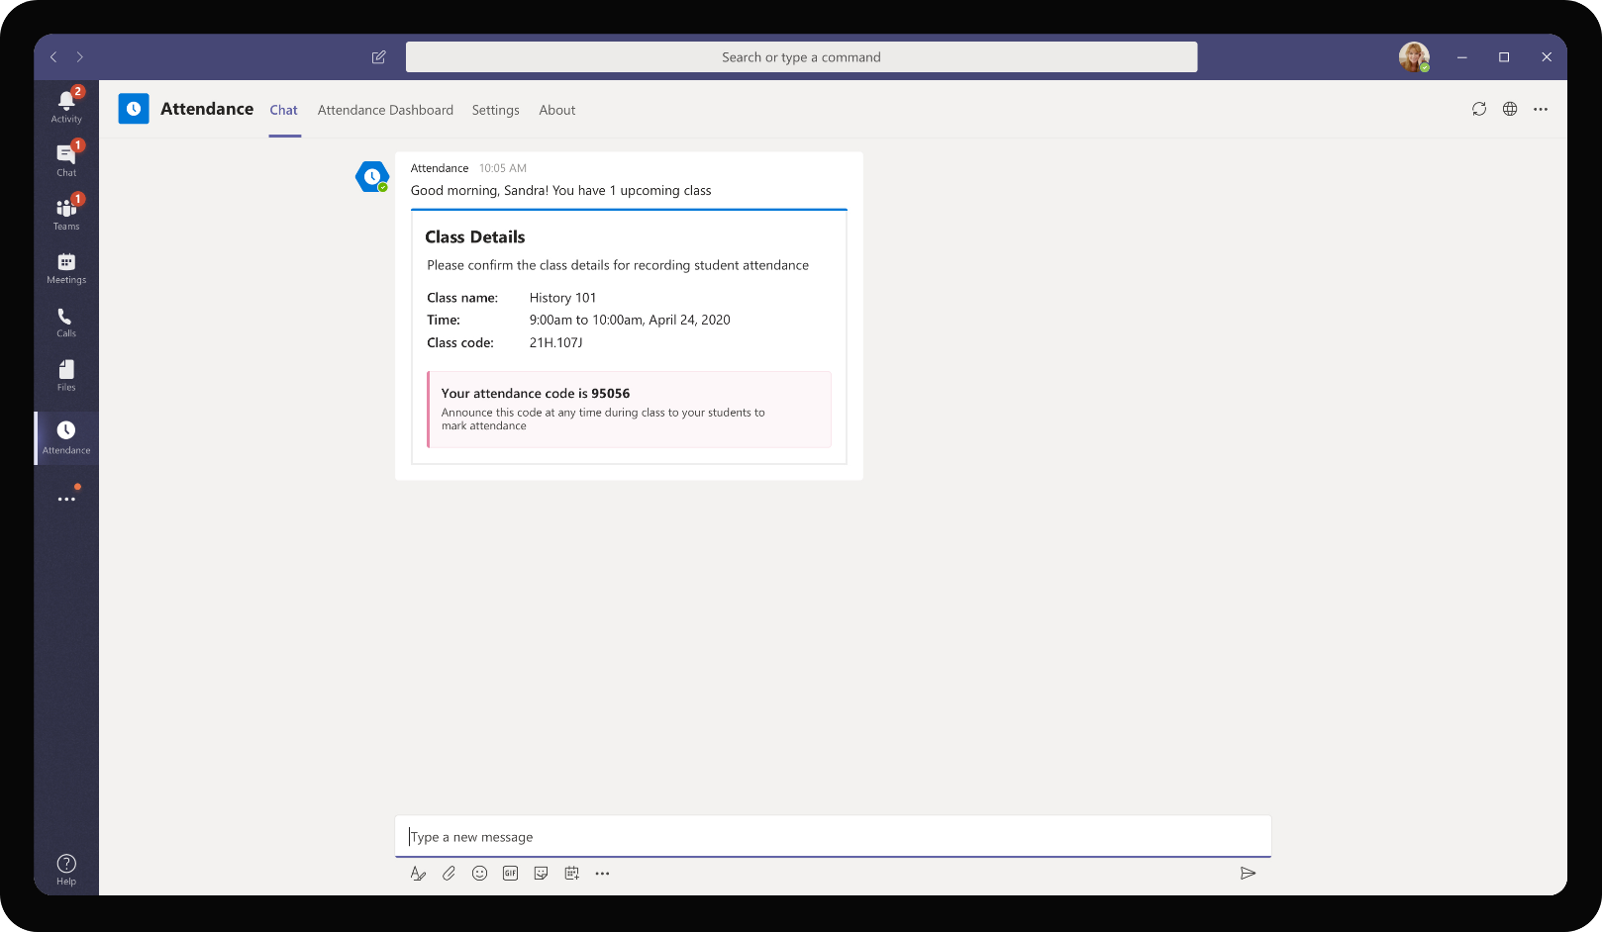
Education – Attendance Management
As Sandra submits, the adaptive card reflects the generated code that Sandra can manually announce during the virtual class session.

Slide 13

Roy Howard, Student
Roy Howard is one of the students in Sandra’s class. Roy has taken a liking to virtual classes online but finds that there is some time wasted in administration activities of marking attendance, applying for leave. Roy also feels it is hard to keep up with change in schedule and timing of classes when it happens virtually

Slide 14
Sandra has to deliver her class as a Teams meeting and wants to easily handle tracking attendance without disrupting the class and wasting class time

Slide 15
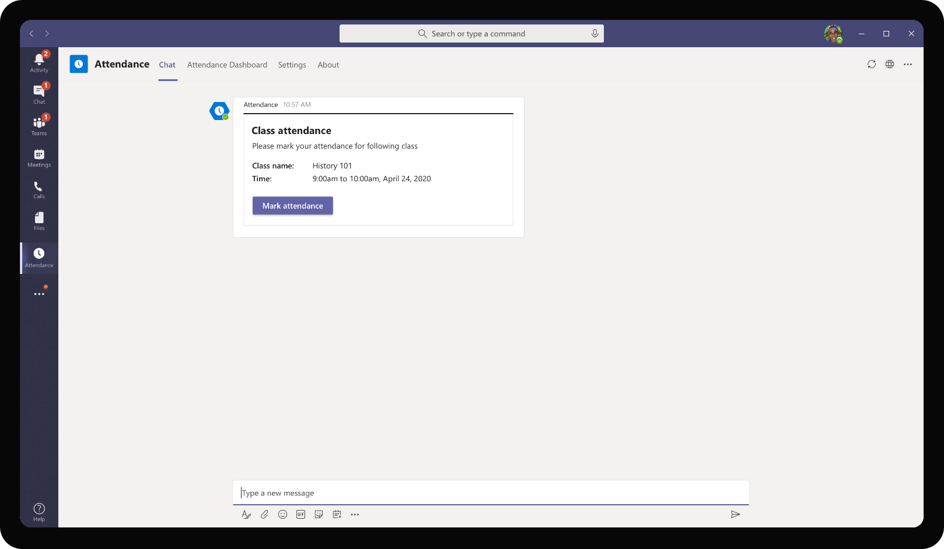
Education – Attendance Management
As Sandra starts the scheduled meeting for her history session, all students in the class get a message on their app from Attendance bot confirming the class details and providing option for students to mark attendance.

Slide 16
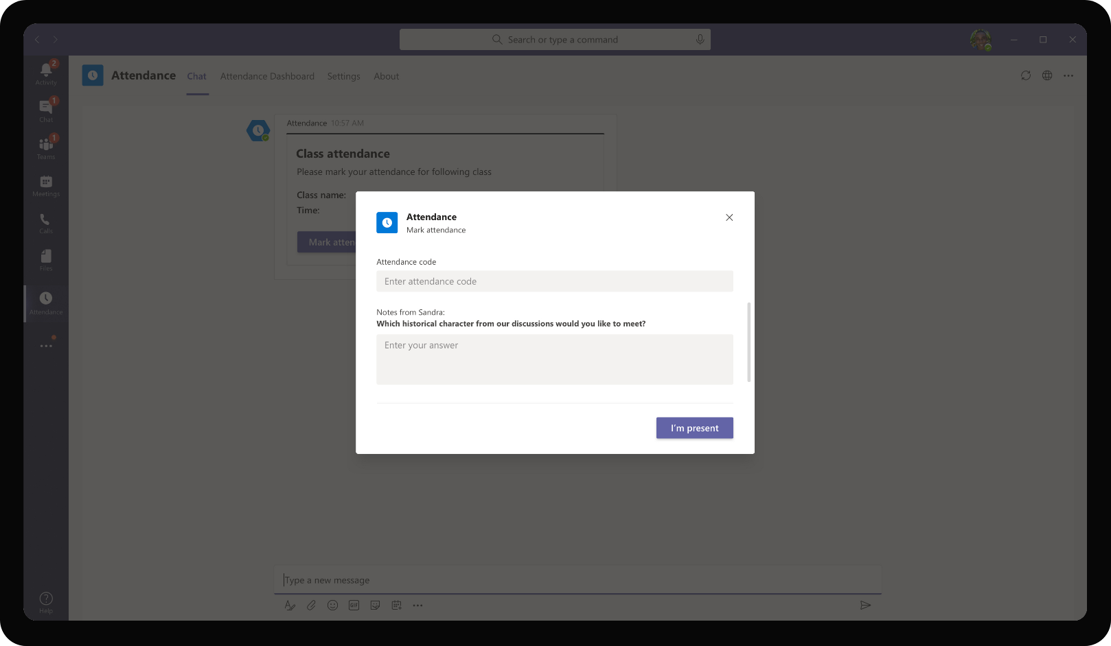
Education – Attendance Management
At any time during the class lecture, Sandra may choose to announce the code over Teams meeting. Sandra may choose to vary the time of announcement of attendance in each class

Slide 17

Education – Attendance Management
As Sandra provides the attendance code over Teams meeting, Roy enters the same in the form for attendance code. In addition, Roy mentions his response to the question posed by Sandra before marking his attendance.

Slide 18
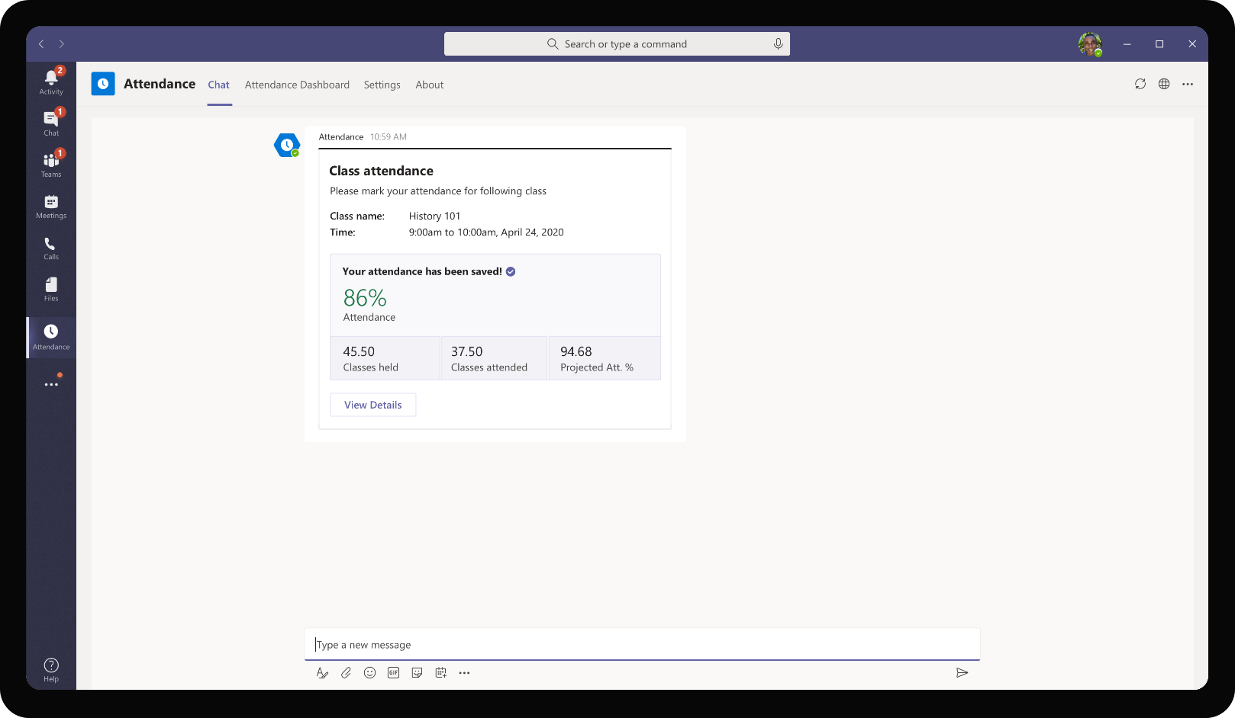
Education – Attendance Management
Once attendance is submitted, Roy gets a snapshot of his attendance percentage for History class. The app also provides an accurate view of protected attendance percentage if Roy continues to attend all classes until end of term.

Slide 19
After class, Sandra prefers to check consolidated view of attendance for her class. She proactively reaches out to students who have low attendance to understand their issues

Slide 20
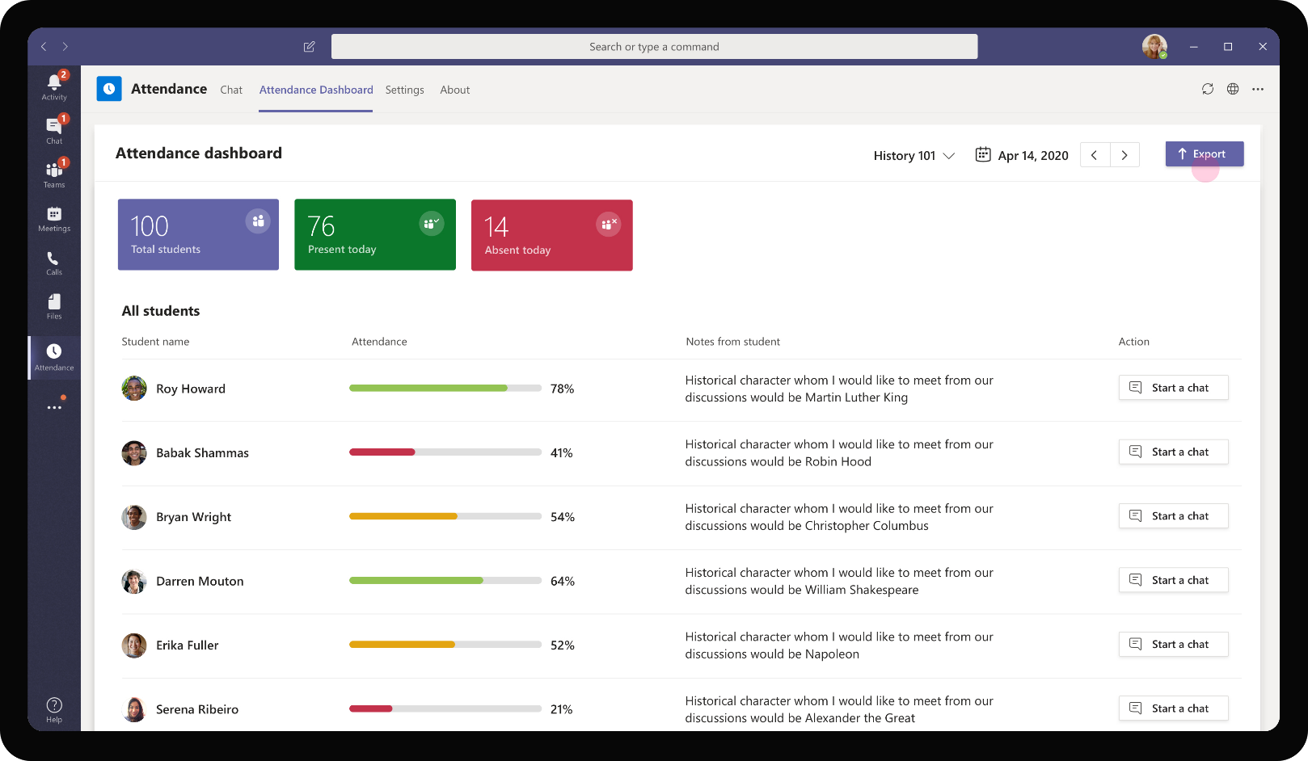
Education – Attendance Management
Sandra’s personal app has an attendance dashboard tab that provides attendance details of all students in her class. She is able to switch between different classes if she handles more than one. It provides clear view of students who are low on attendance for Sandra to reach out.

Slide 21
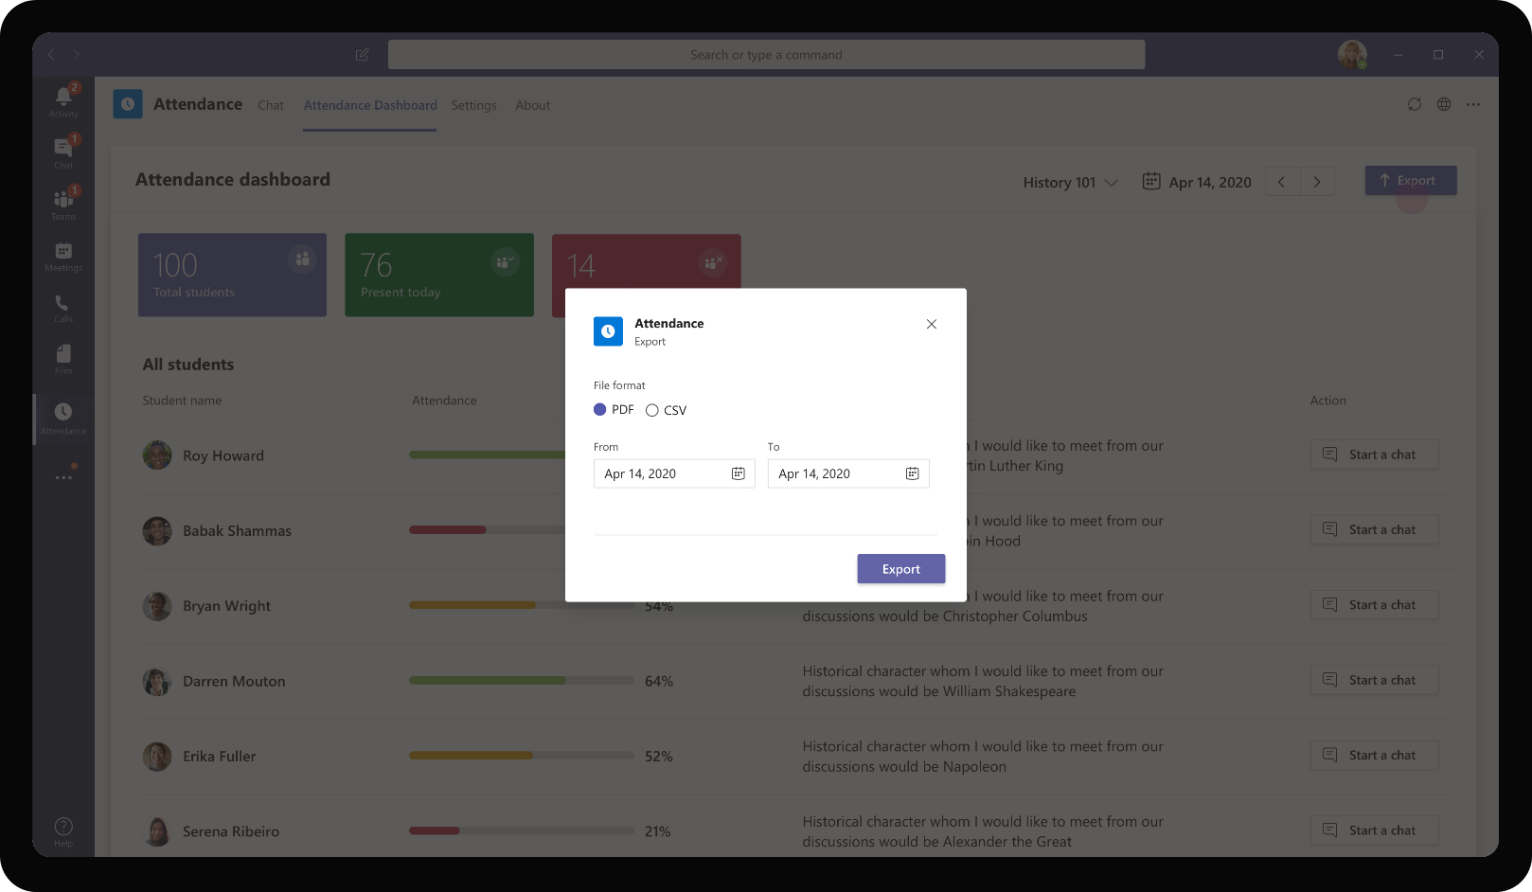
Education – Attendance Management
The app also provides an easy way for Sandra to download the attendance details over a range of dates as a csv file for any further analysis

Slide 22
Roy Howard, Student
Roy Howard is one of the students in Sandra’s class. Roy has taken a liking to virtual classes online but finds that there is some time wasted in administration activities of marking attendance, applying for leave. Roy also feels it is hard to keep up with change in schedule and timing of classes when it happens virtually

Slide 23
Roy is representing his school in a sports event and needs to apply for leave of absence from school administration

Slide 24
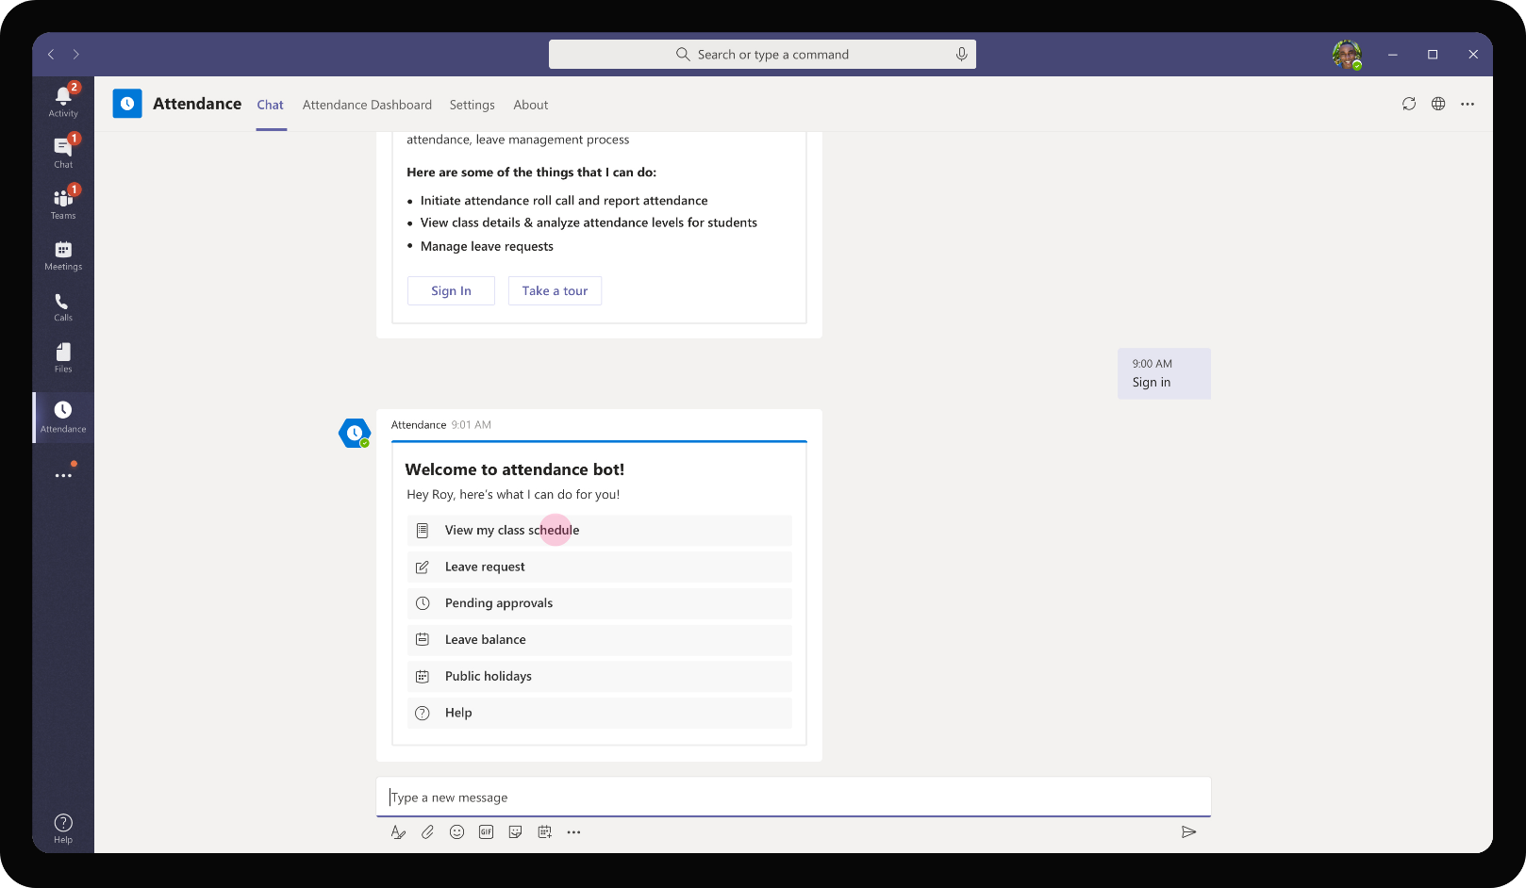
Education – Attendance Management
As Roy logs in to the app, he is greeted with a set of options available for a student. Roy wants to see the class schedule for the day to check the classes he would be missing.

Slide 25
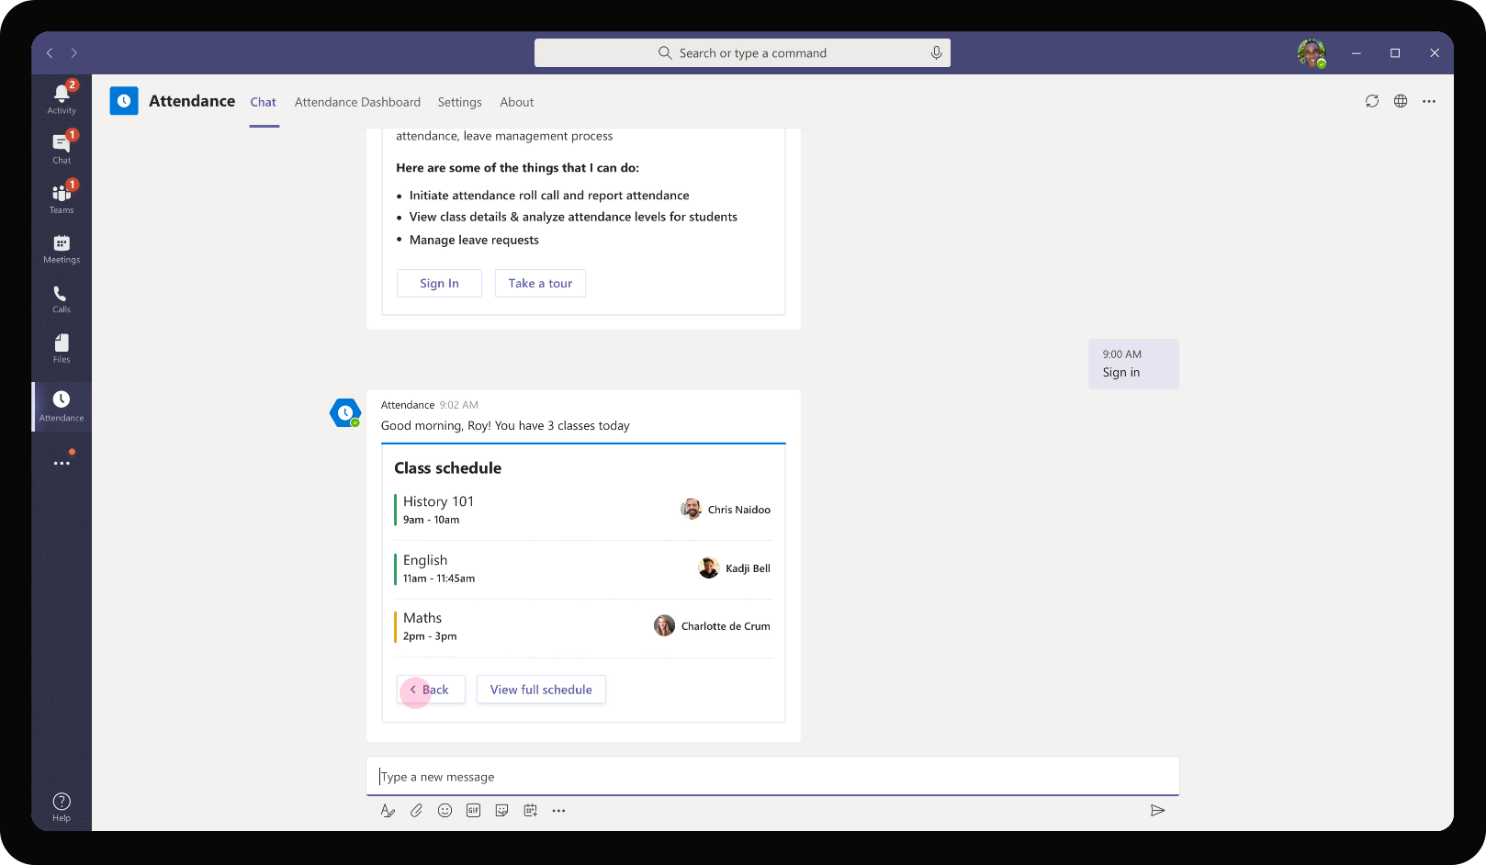
Education – Attendance Management
On viewing the class schedule, the adaptive card refreshes to show the classes in his day with the professors who would be leading the class.

Slide 26

Education – Attendance Management
Roy gets back to the original menu of options to apply for a leave

Slide 27
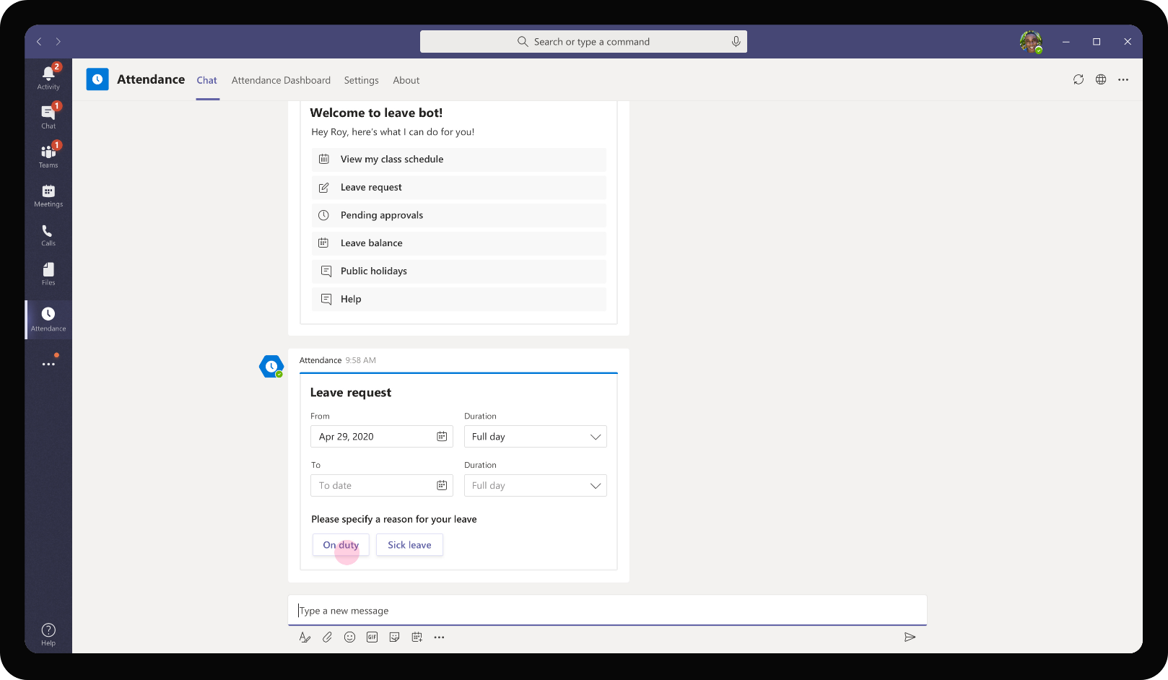
Education – Attendance Management
After filling in required details, Roy chooses the reason for leave as On Duty as is going to be absent representing the school in a sports event.

Slide 28
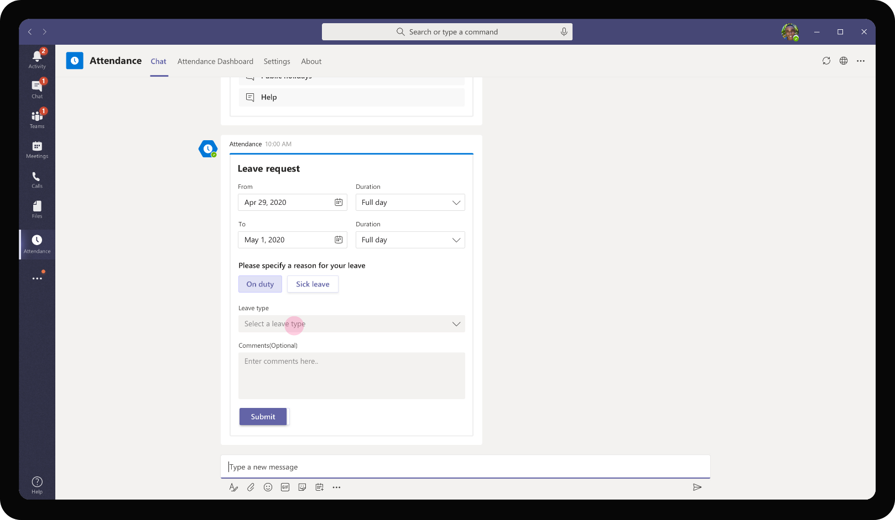
Education – Attendance Management
The card expands to show further options relevant to On Duty category of leave requests.

Slide 29

Education – Attendance Management
Roy chooses the type of event he will be attending on duty. Since he is representing the school in a sports meet, he chooses the sports event option.

Slide 30

Education – Attendance Management
In the comments box, Roy provides additional justification that will be presented to the administration. The administration can view this justification before approving the leave request.

Slide 31
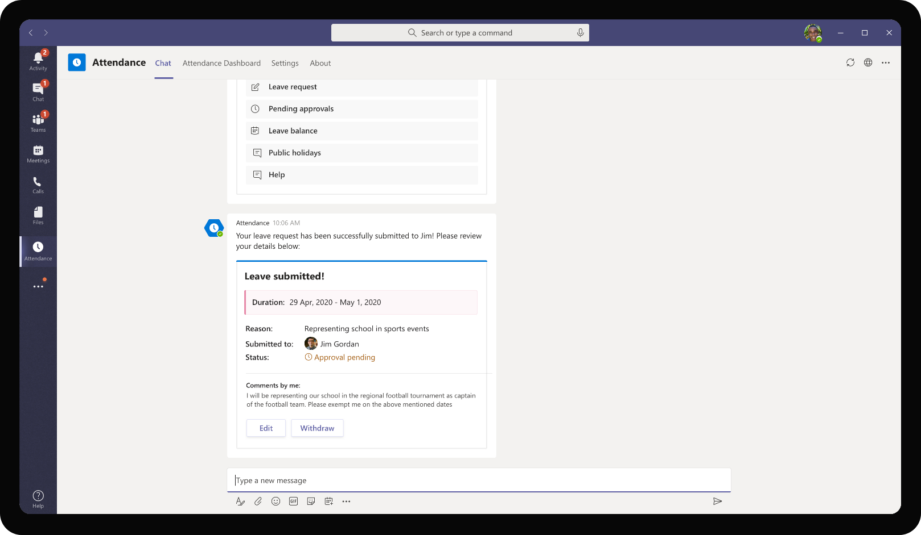
Education – Attendance Management
As Roy submits the request, the card shows a summary of Roy’s leave request. It highlights the administration lead who is responsible for approving the request and the status of approval.

Slide 32
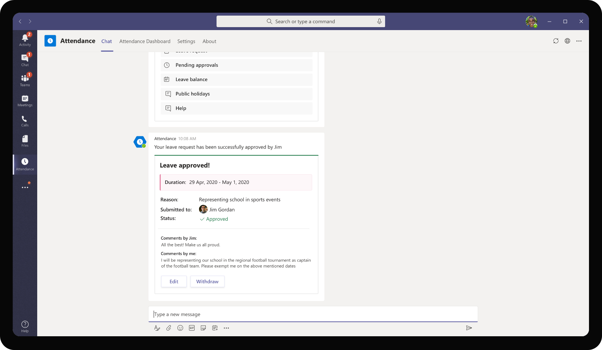
Education – Attendance Management
Once Jim Gordon approves the request, Roy’s leave request card refreshes to show the approval status as ‘Approved’ and shows comments from the approver.

Slide 33
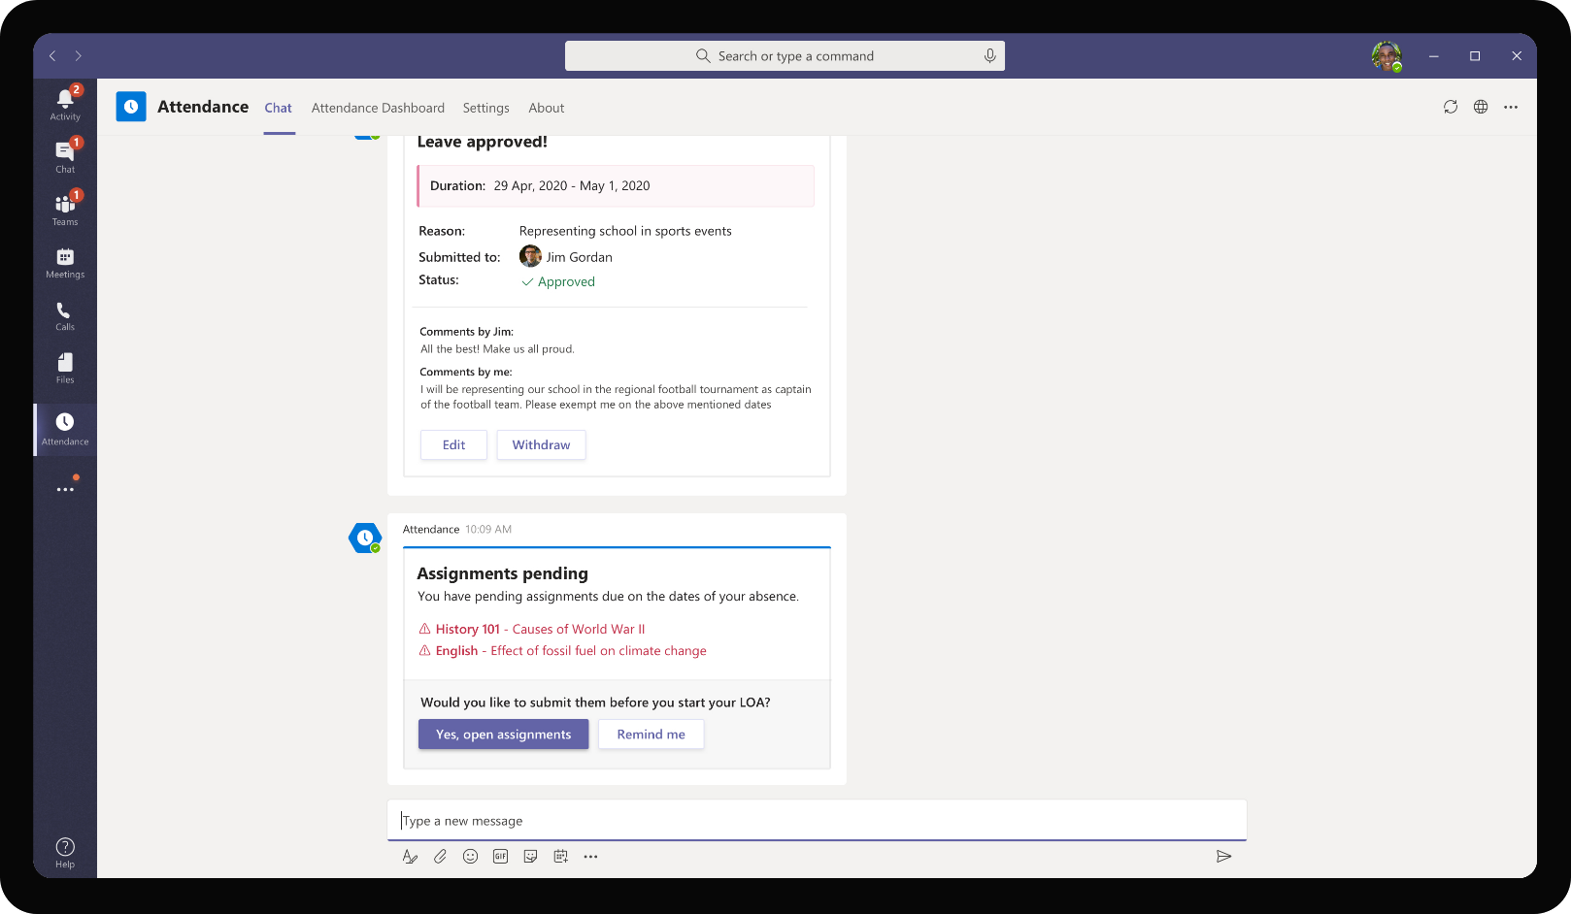
Education – Attendance Management
The app recognizes that Roy will be absent on the specified leave request days. It checks if Roy has any pending assignments due on those dates and reminds him to submit the assignments so as to not miss the deadline.

Slide 34

Jim Gordon, Administrator
Jim Gordon is a member of school administration is responsible for handling leave requests of certain classes. Jim verifies leave exemptions that are submitted by students and is responsible for easing the life of students steering them away from admin and paperwork for simple tasks.

Slide 35
Jim Gordon receives leave approval requests among other administrative tasks from high school students

Slide 36
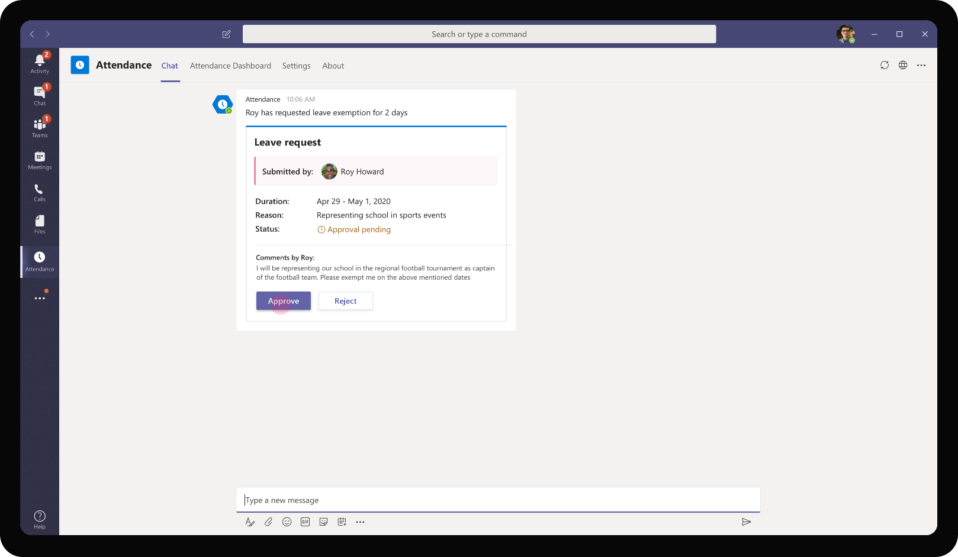
Education – Attendance Management
As Jim goes about his day, he receives request from Roy Howard for approving a leave request for 2 days. Jim sees that Roy has also provided the required justification for exemption.

Slide 37
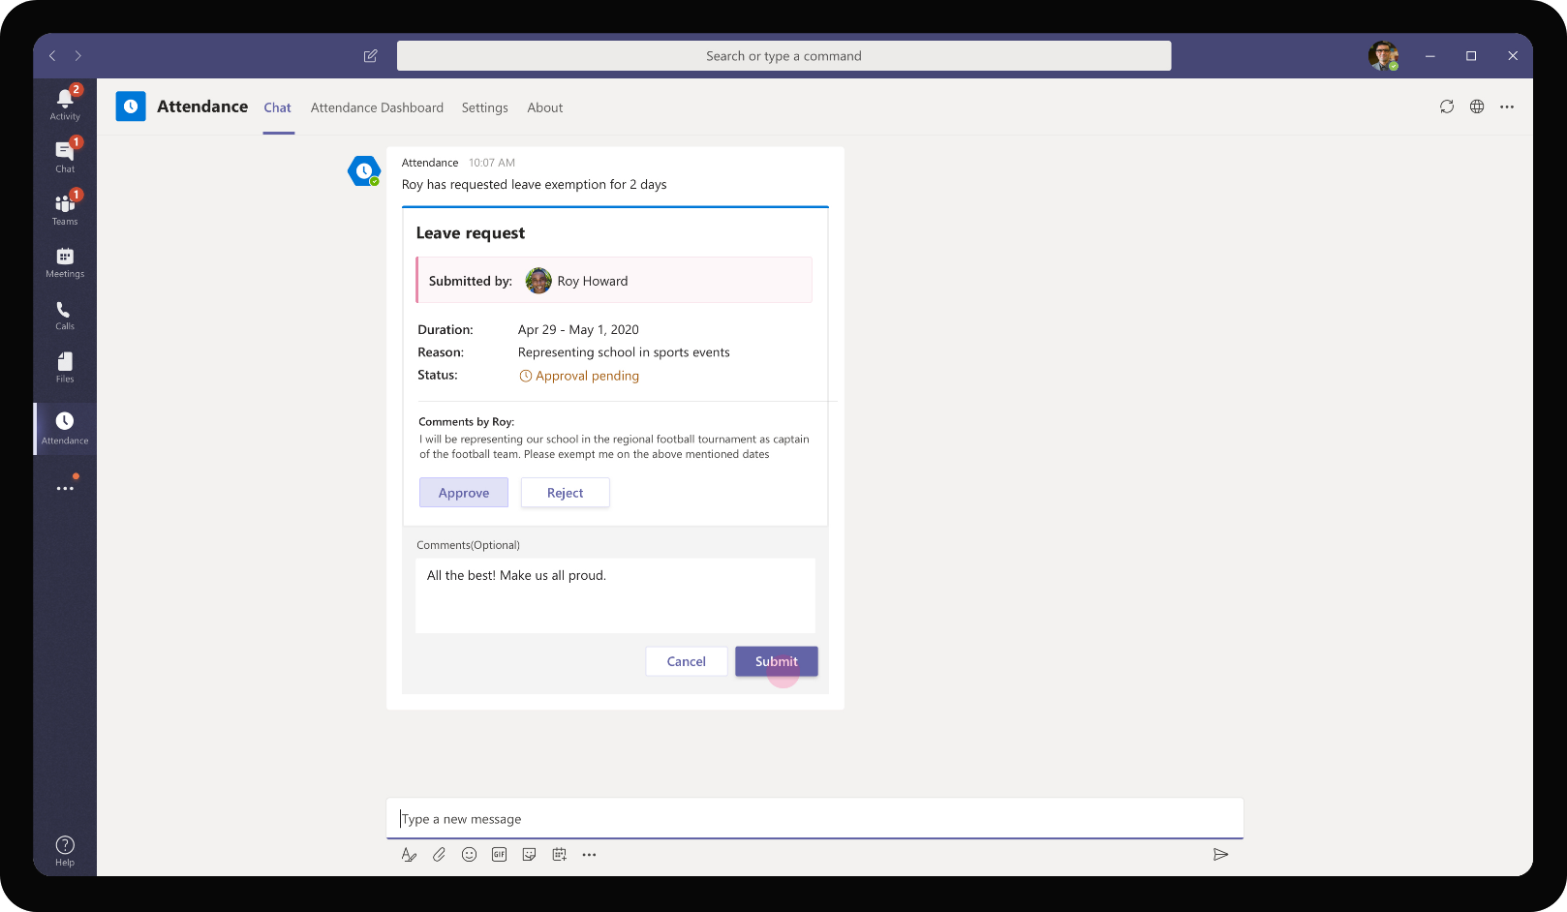
Education – Attendance Management
As the request is valid and Jim is aware of the upcoming sports meet, he proceeds to approve the request right away.

Slide 38
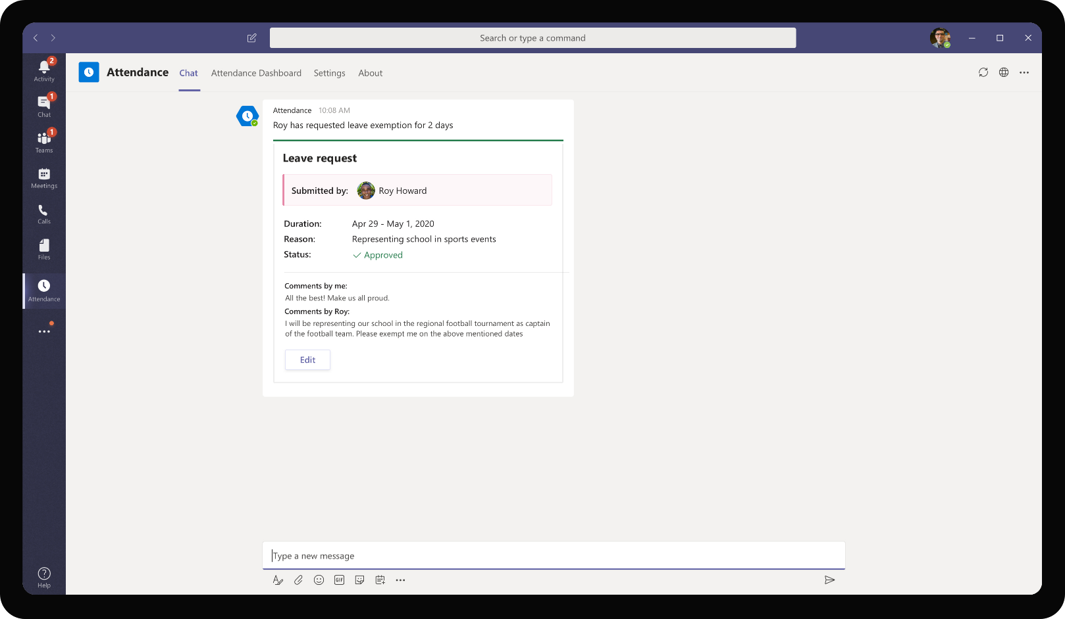
Education – Attendance Management
The app provides confirmation of approval back to Jim and he is able to edit the request if required.

Slide 39
Solution Highlights – Best Practices
Education – Attendance Management
Key Solution Design Considerations
Platform Extension Points
User Experience
Personal Scoped App The app is designed as a personal scope app for the teacher as information that the teacher needs to access would be pertaining to their class / subjects and not relevant for other teachers. In addition, it should not be visible for students as well. It is essentially information useful for each teacher individually
The adaptive card which asks students to enter their attendance code can be implemented as a card in channel scope as well. This would require configuring of right channels for each subject / class as part of app experience
Personal Bot – A personal scope bot handles all attendance and leave management requests. Since attendance and leave management are performed at a student level, a personal bot is used here. There is no reason for a student’s attendance %, leave balance etc. need to be displayed in a Team / channel. It’s personal for each student using the app
Card refreshes are used to update the card status instead of sending multiple different cards about the same request. This is especially useful in leave management flow. One leave request card gets constantly updated to show statuses under review and approved by the administrator. This ensures that readability is easier, and app does not spam with multiple cards for updates.
List cards are used for providing a single consolidated view of a student or teacher’s day along, show a list of classes that are clickable to view additional details about a particular class.
Proactive Messages are used to send attendance code check-ins for students to fill in during a class.
Graph API
The app utilizes Get onlineMeeting Graph API to retrieve list of users who are invited for a particular meeting. The attendance check-in proactive message is then sent to these participant students for each class

Slide 40





Solution Architecture
Education – Attendance Management
Azure Subscription
AAD
Graph API
SSO and Reporting org
Fetch meeting, user pictures
Bot / Task Module
Meetings, POST attendance
Teacher
MS Teams
Bot Registration
Attendance
App Service
GET Attendance %
GET Student Attendance
Student
Attendance Database
Azure Table Storage (Leave requests, student responses)

Slide 41
Academics Assistant
Education Book of Dreams

Slide 42

Scenario Vision
Student
Context
Daniel, a student at Contoso university is juggling between his academic coursework, part time job, extra and co-curricular activities. He prefers a centralized hub to manage all his day-to-day activities, tasks and coursework in a structured manner.
He uses Teams for interacting with his class mates and collaborate on coursework related deliverables. In addition, his online classes take place as Teams meetings
Current State
Daniel’s classes may undergo changes in schedule from time to time. This could include last minute changes in the venue of class if they are physical classes, or timing of a class due to events where some classes may get postponed.
These ad hoc changes are typically communicated to Daniel and rest of his classmates via email. While this works at times, there have been cases that Daniel has missed this email and went unaware of changes in class schedule.
During a class, Daniel takes notes documenting key concepts discussed in his notebook. He shares them with his classmates from time to time for them to scan / take photocopy of it
While it works for small groups, there was no scalable way for everyone to work together.
Administration’s announcements at Contoso regarding admin activities, scholarship, fee deadlines, club enrolments are usually pinned on notice board
Interactions between classmates, assignment deadline changes all happen through personal groups on various platforms.
Future State
Daniel signs onto his Teams app and is prompted to check out a central hub which shows the day’s schedule for him along with upcoming deadlines, tasks
Whenever there is an announcement from the professor or from school administration, the app alerts Daniel to check out the announcement right within the app
Daniel is able to view change of schedule, upcoming classes. He also joins his online classes directly from the app notification
During the class, Daniel is able to invoke from the app from Teams meeting and take notes and action items directly within the class
After the class is complete, the app automatically collects Daniel’s consent to share his notes in the common class notebook for all classmates to view and consume. Daniel also gets access to others notes as the app encourages good behavior through gamification
Administration’s announcements on leave policy changes, scholarship updates are broadcasted to different classes and available for each student to view within the app instantly
Classmates all use Teams to interact with each other and share notes, course content with each other in one single platform
- Points of Friction

Slide 43

Daniel Tao, Student
Daniel is a student of Physics at Contoso University. He has a packed course workload, and he is active across multiple extra and co-curricular clubs in the university as well. His primary challenge is staying on top of information that comes from his professors, club members and school administration which are scattered across different mediums.

Slide 44
Sandra has to deliver her class as a Teams meeting and wants to easily handle tracking attendance without disrupting the class and wasting class time

Slide 45
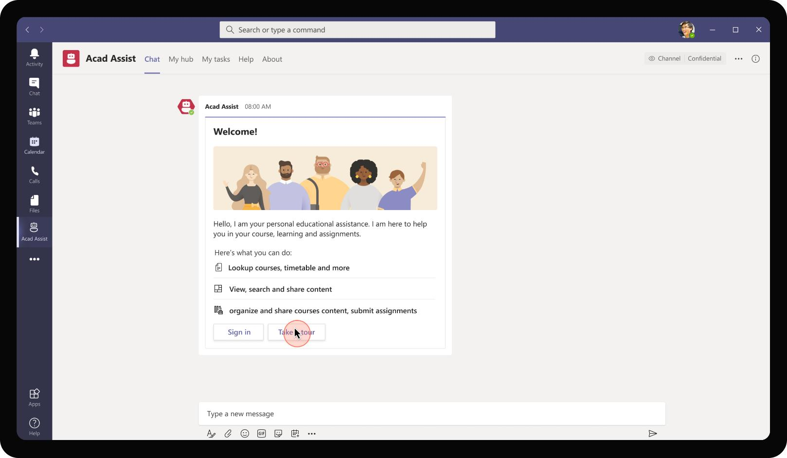
Education – Academics Assistant
The app sends a welcome message on installation introducing the various features. Daniel Tao uses the take tour button to view various features of the app.

Slide 46
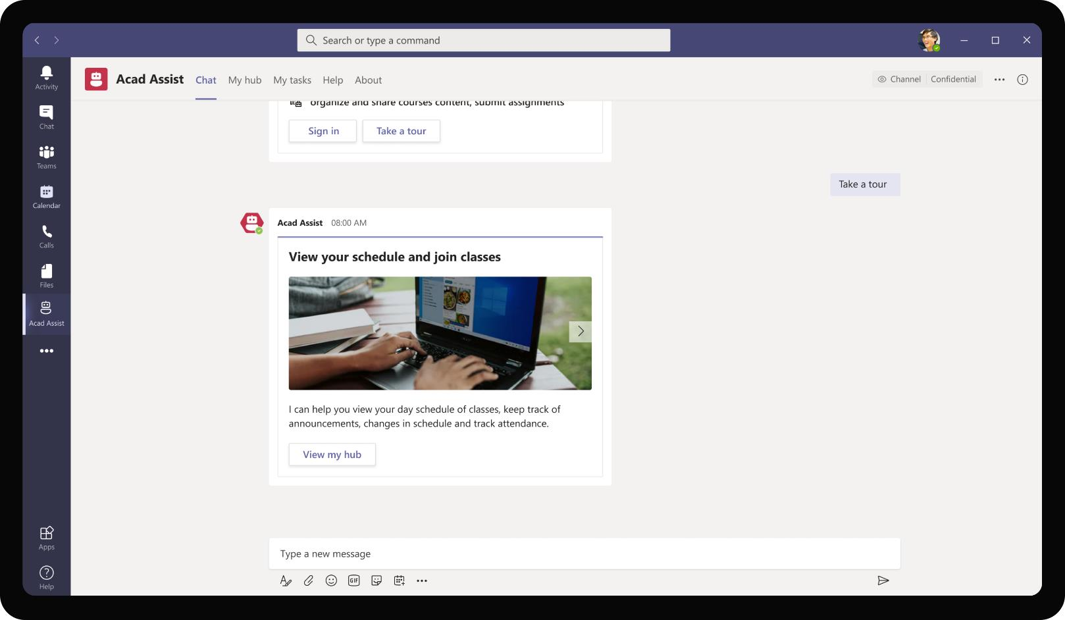

Education – Academics Assistant
The app provides an introduction to the various capabilities that it offers clearly highlighting how Daniel can make use of it for his day to day activities. It prompts Daniel to explore the student hub. On clicking the button, Daniel is taken to view the My Hub tab of the app.

Slide 47
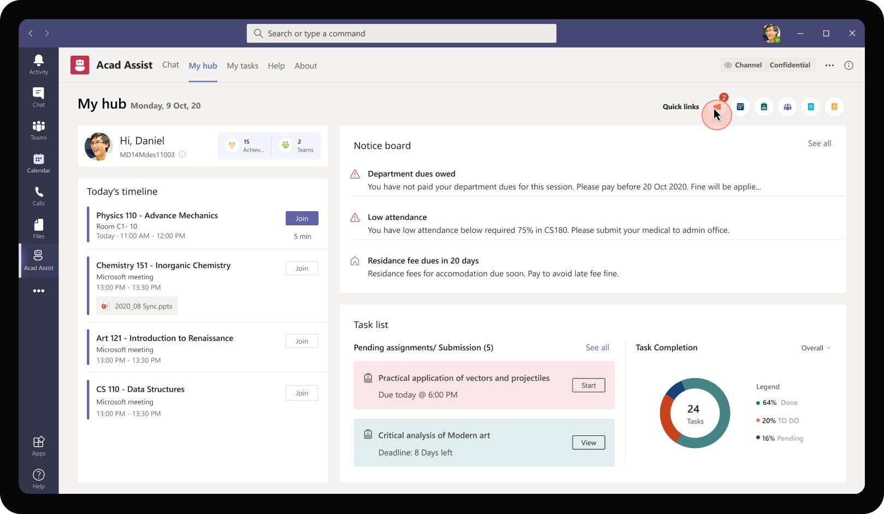
Education – Academics Assistant
Daniel starts his day looking at this personalized hub. It shows among other things, Daniel’s classes for the day. The hub also acts as a virtual notice board for Daniel to view announcements that come from his classes, university. It also provides a central place for him to keep track of his tasks and assignments.

Slide 48
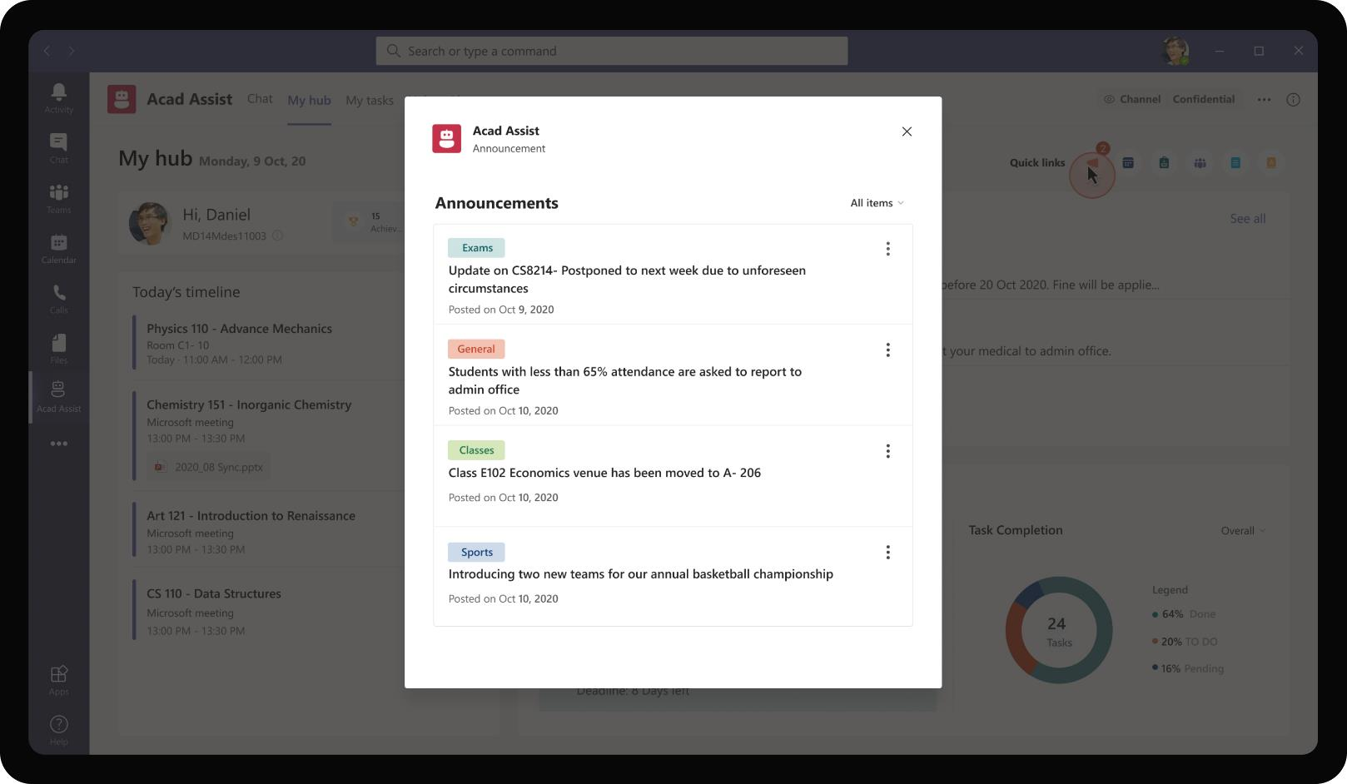
Education – Academics Assistant
Clicking on the ‘announcements’ icon, opens a task module with filterable list of announcements from different classes made by his professors, school administrators. Daniel can view all important announcements for the day and plan his day accordingly.

Slide 49
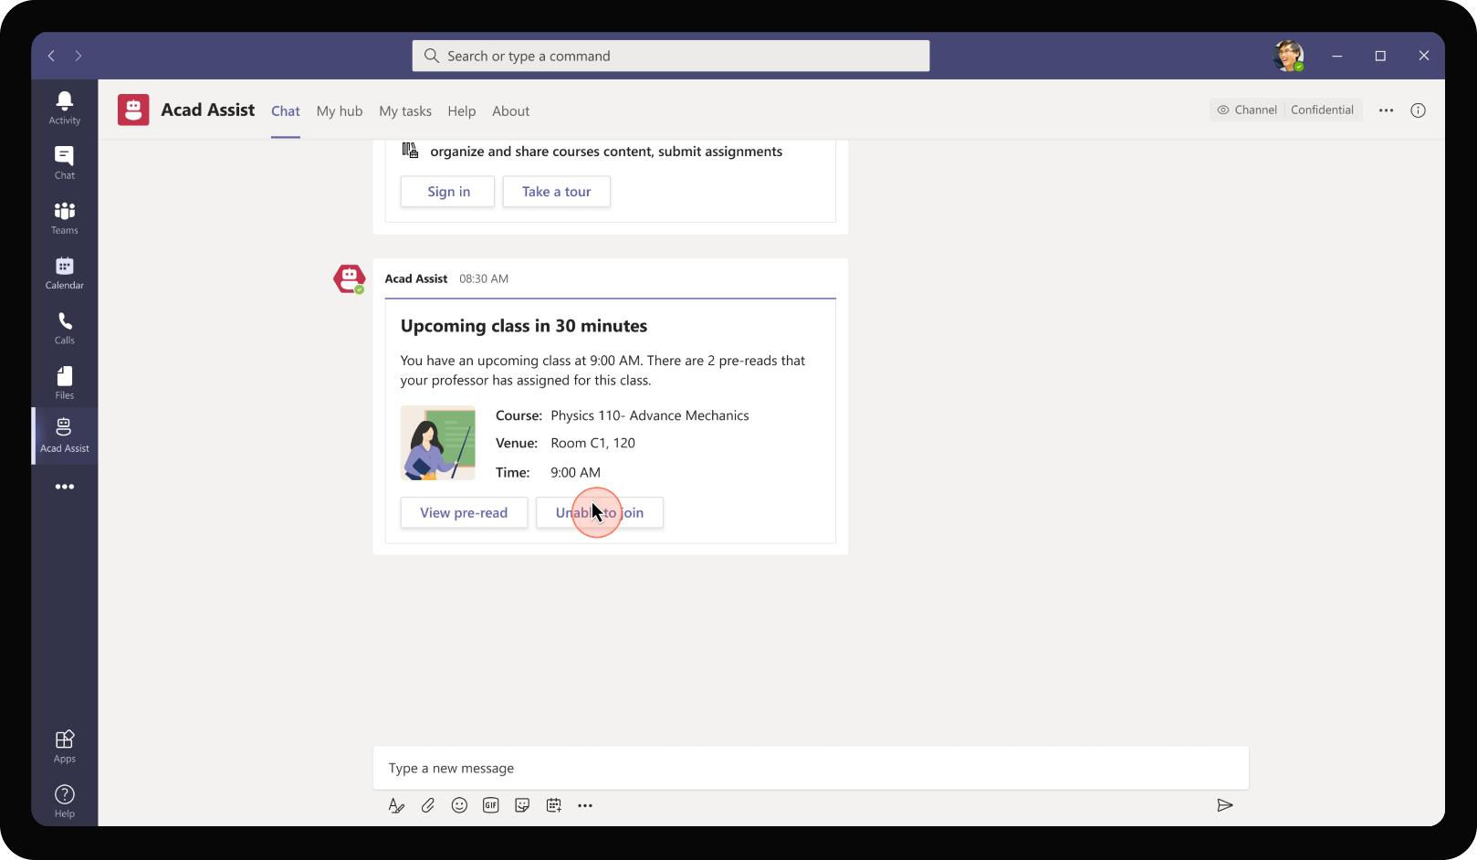
Education – Academics Assistant
The app sends reminders to Daniel of upcoming classes. It also provides link to pre-read materials that a student must read up before attending the class for quick reference.

Slide 50
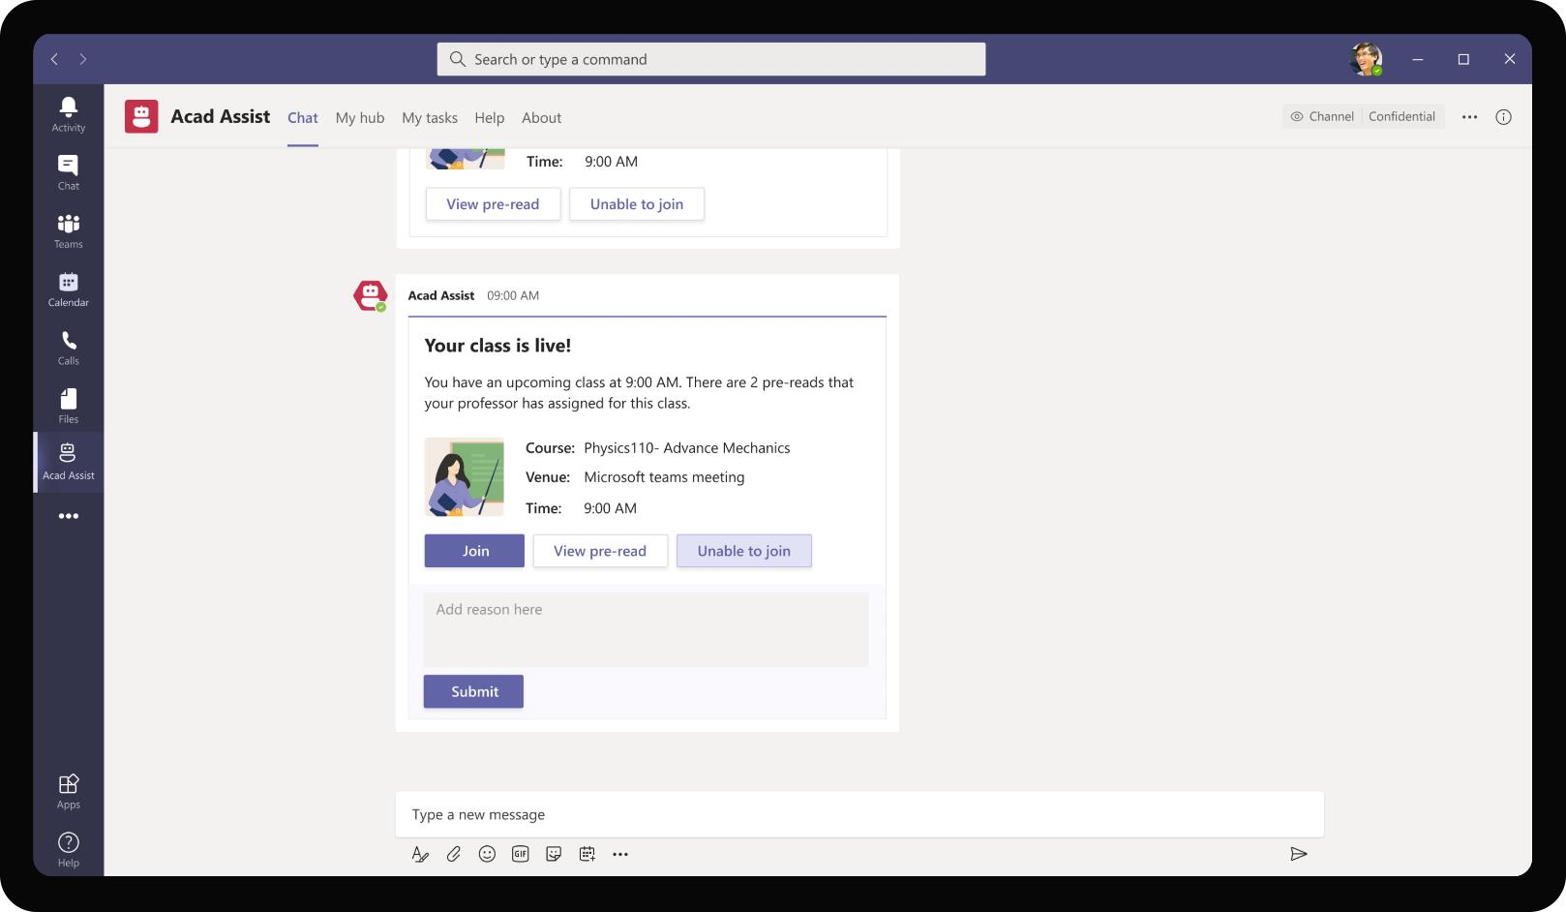
Education – Academics Assistant
If a student is unable to join for some reason, he can use the bot message to mark himself as absent for the class intimating the professor promptly.

Slide 51
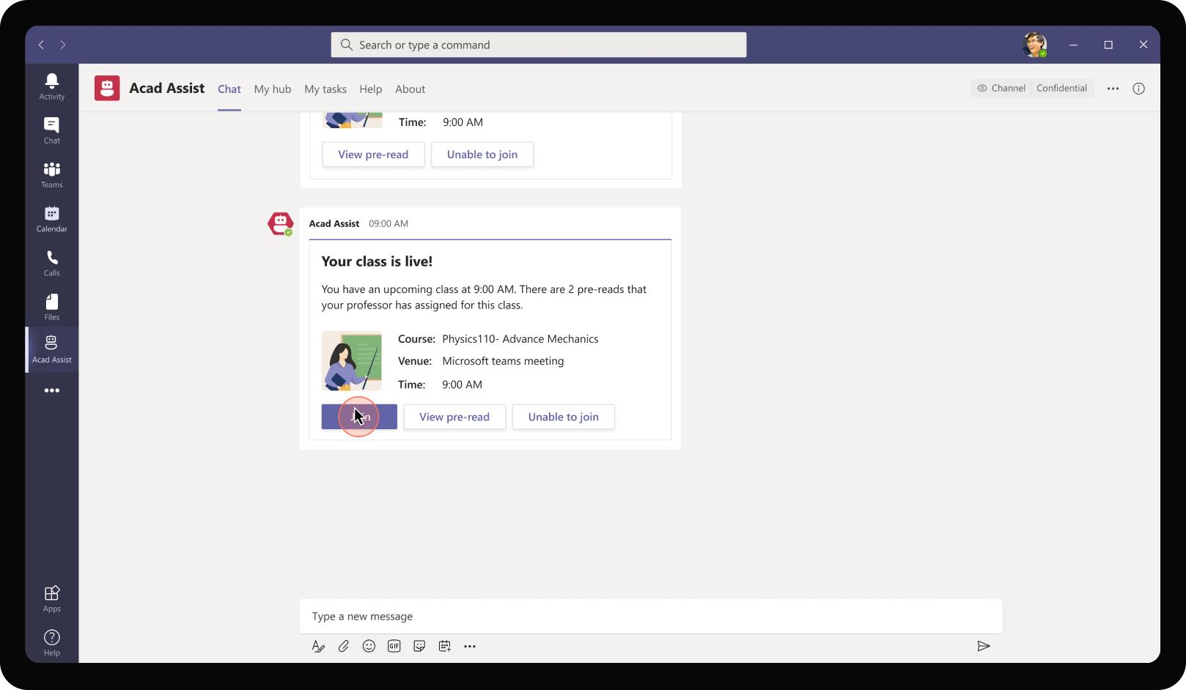
Education – Academics Assistant
As the class becomes live (at scheduled start time), the app prompts Daniel to join the Teams meeting. Daniel can join the meeting directly from the bot message.

Slide 52
Daniel Tao joins a virtual class along with his class mates. He takes frequent notes from the lecture and makes pointers to himself to revise on key concepts in the class.

Slide 53
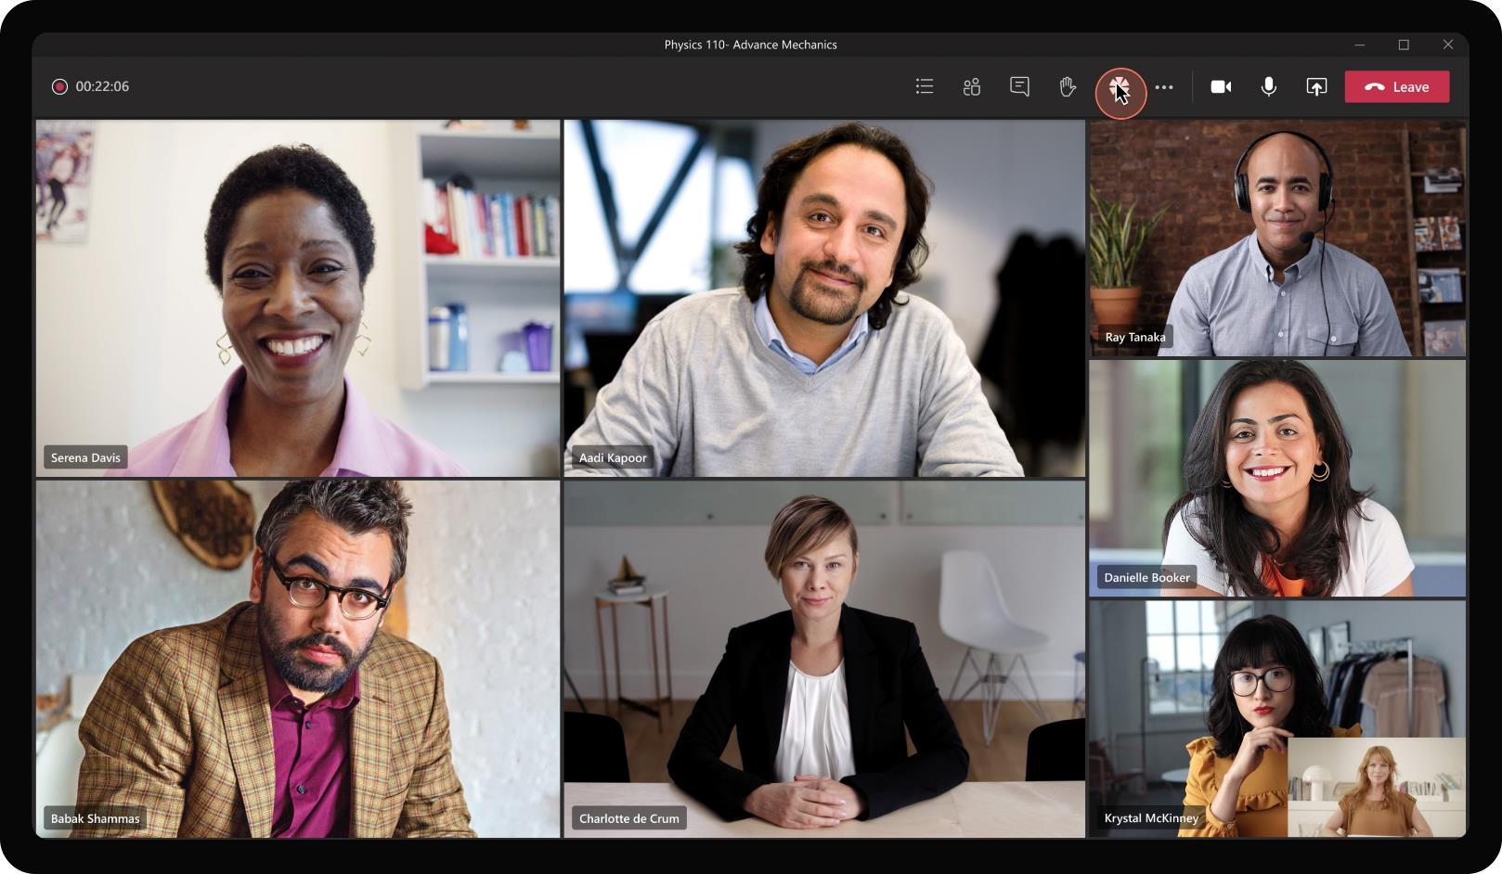
Education – Academics Assistant
As students join the class, they see other classmates and professors on the video call with professor delivering the lecture.

Slide 54
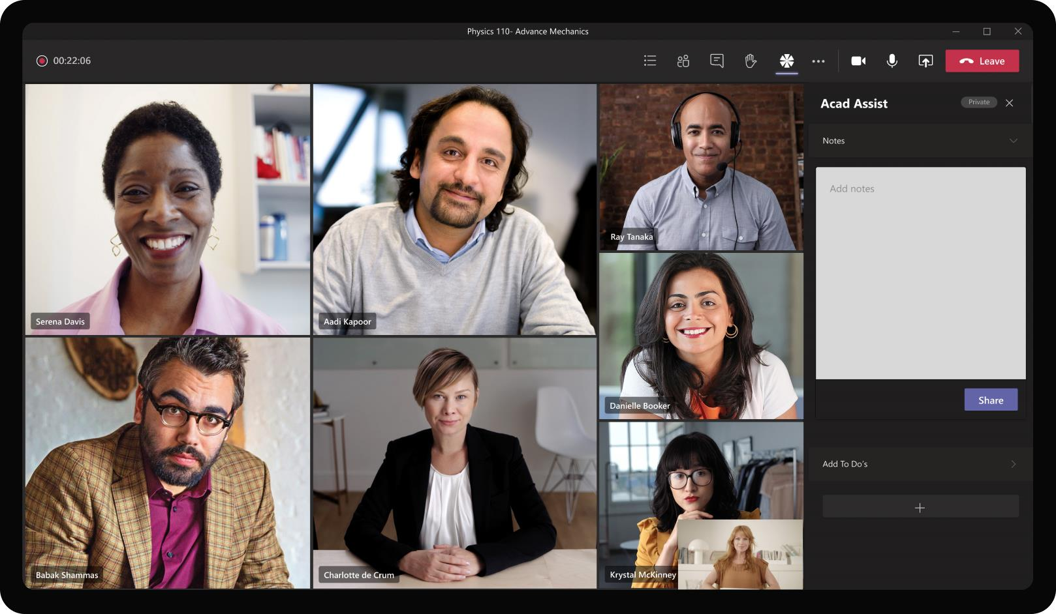
Education – Academics Assistant
App also provides additional surfaces on the meeting side panel for students to take notes during the class. Daniel can take notes in the notes section on the side panel without having to switch to another screen.

Slide 55
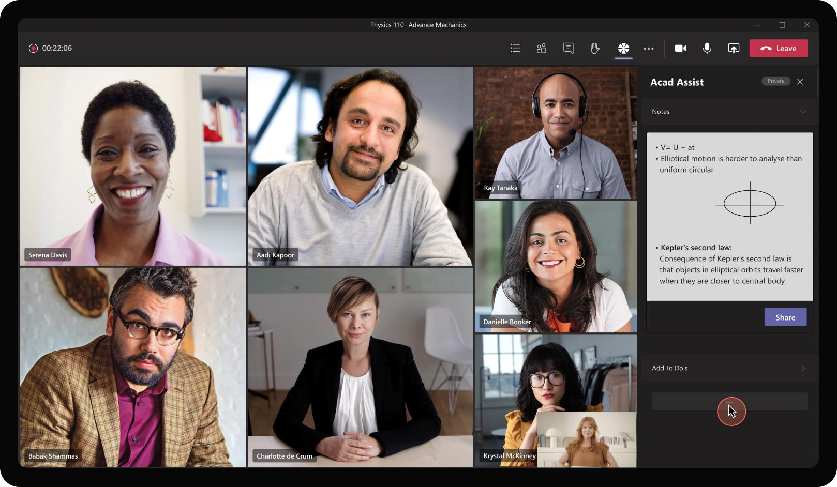
Education – Academics Assistant
As the professor shares content on the screen, uses diagrams to deliver lecture, the notes section can be used to copy the concepts presented and take notes with a mixture of picture and text.

Slide 56
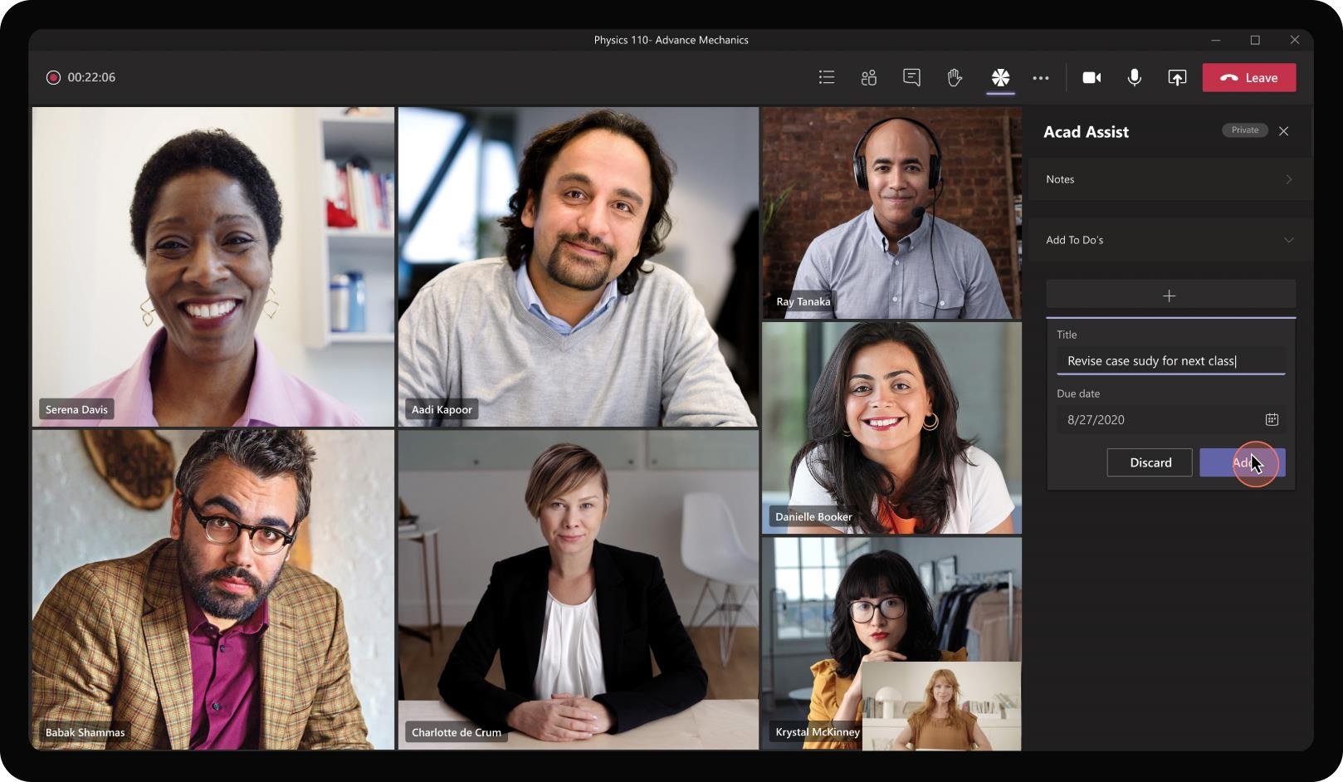
Education – Academics Assistant
As the professor highlights certain follow-up items, provides mini activities for the class, students can make a To Do list on the app using the side panel. Daniel uses the To Do list to make reminders for a case study read up for next week.

Slide 57
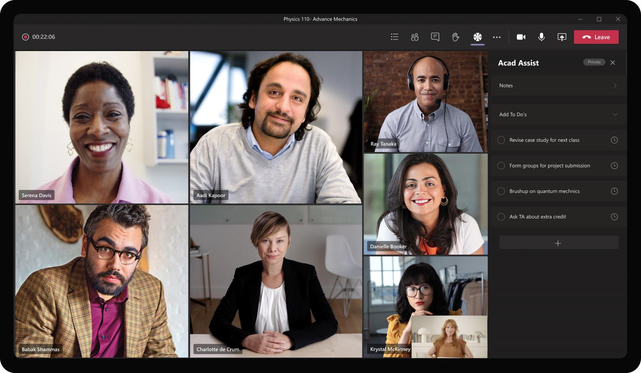
Education – Academics Assistant
To Do list created in the app utilize Tasks in background and are automatically synced to Planner and To Do lists in Windows. Daniel will be able to track and mark them complete across any of these surfaces.

Slide 58
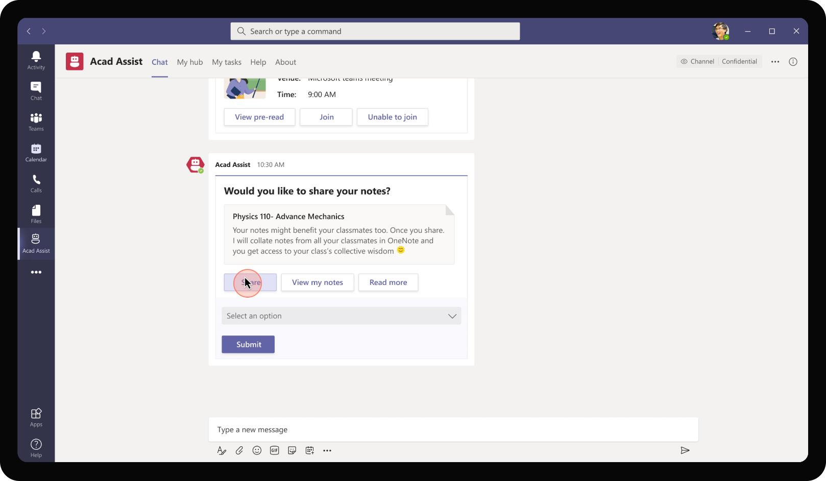
Education – Academics Assistant
Notes captured by Daniel are auto saved in personal OneNote. After the lecture is complete, the app prompts Daniel to share his notes with his entire class and in return get everyone’s notes in a single place for the lecture.

Slide 59
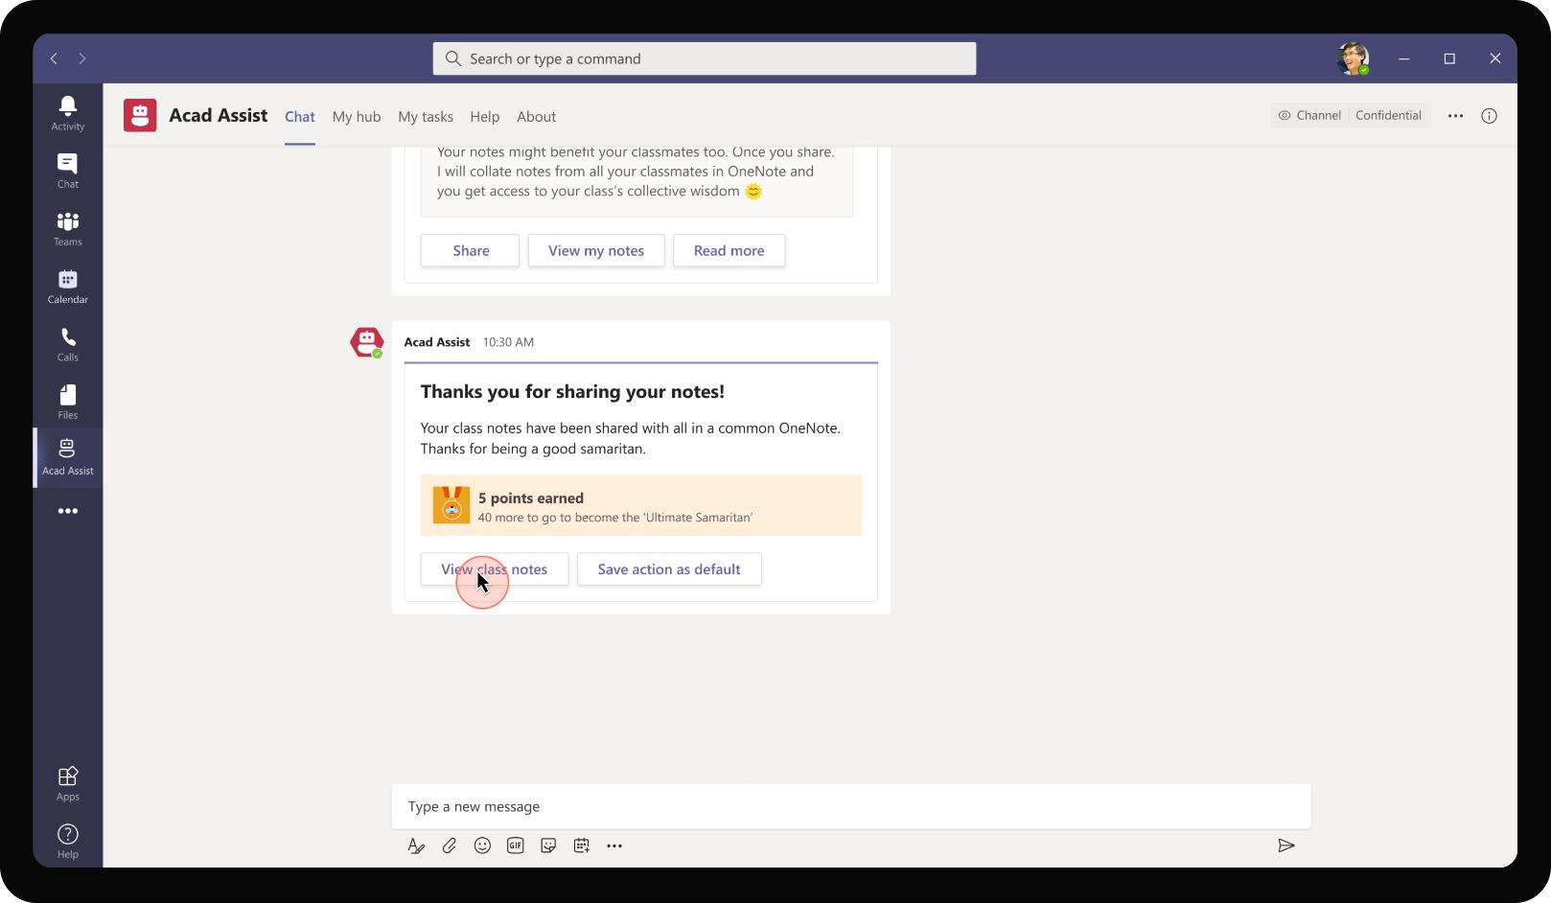
Education – Academics Assistant
The app also gamifies such positive or favourable actions taken by students accumulating points and unlocking badges in the process. This encourages students to collaborate with the class, share notes, clarify questions from classmates and learn as a team.

Slide 60
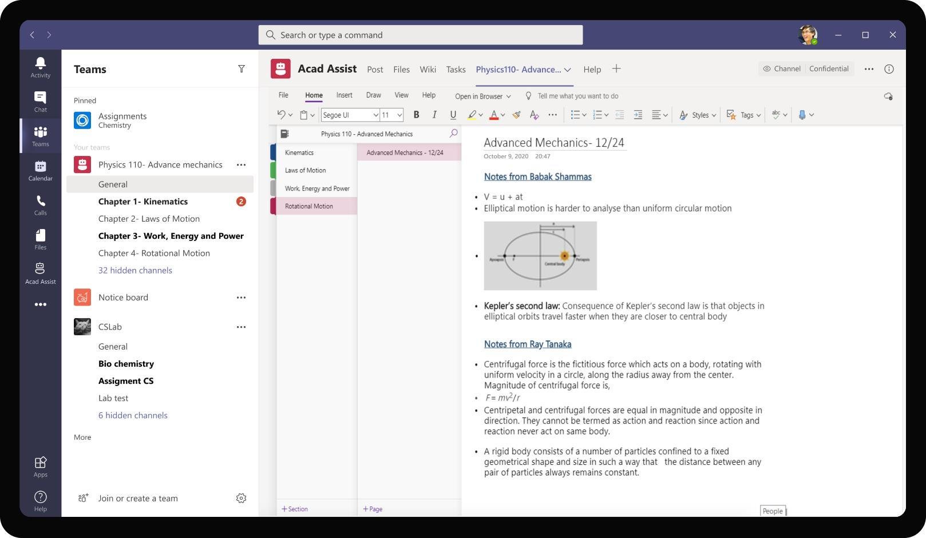
Education – Academics Assistant
The shared note is aggregated under a page specifically created for the lecture. Notes from all class mates get saved in a central place and pinned to the General channel of course Team. This ensures high visibility and easy access for all classmates

Slide 61
The action items captured by Daniel during class are surfaced by the app as reminders to complete as they near due date

Slide 62
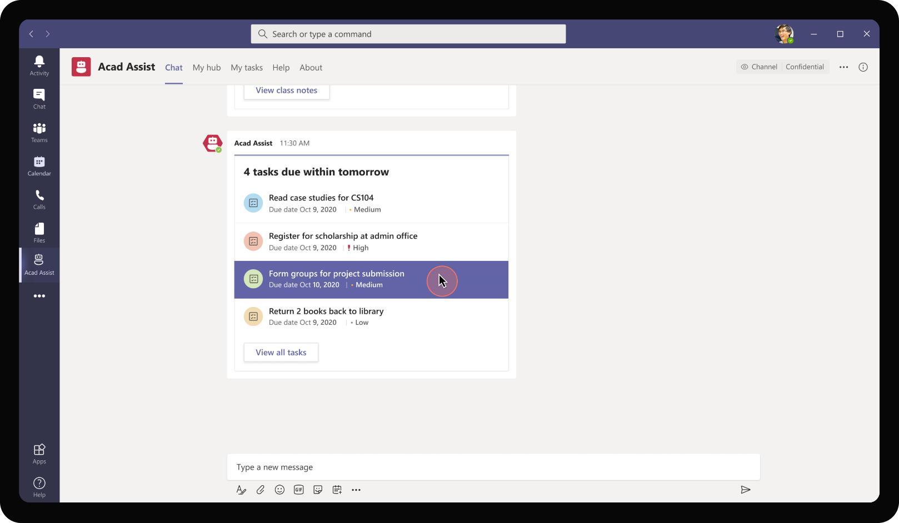
Education – Academics Assistant
Daniel’s action items across various classes are proactively surfaced by the bot close to due date. Daniel is able to see all action items at a glance and take actions on them

Slide 63
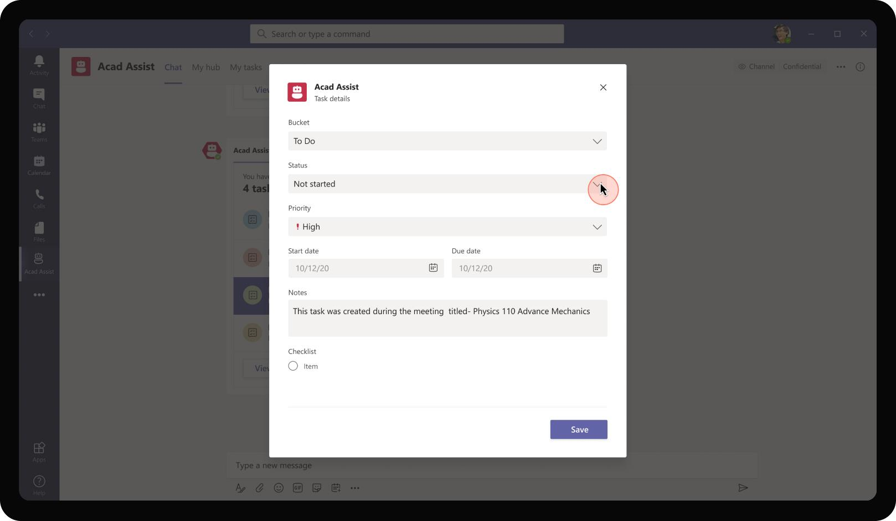
Education – Academics Assistant
Clicking on a specific task opens a task module with provision to update status, edit information as required.

Slide 64
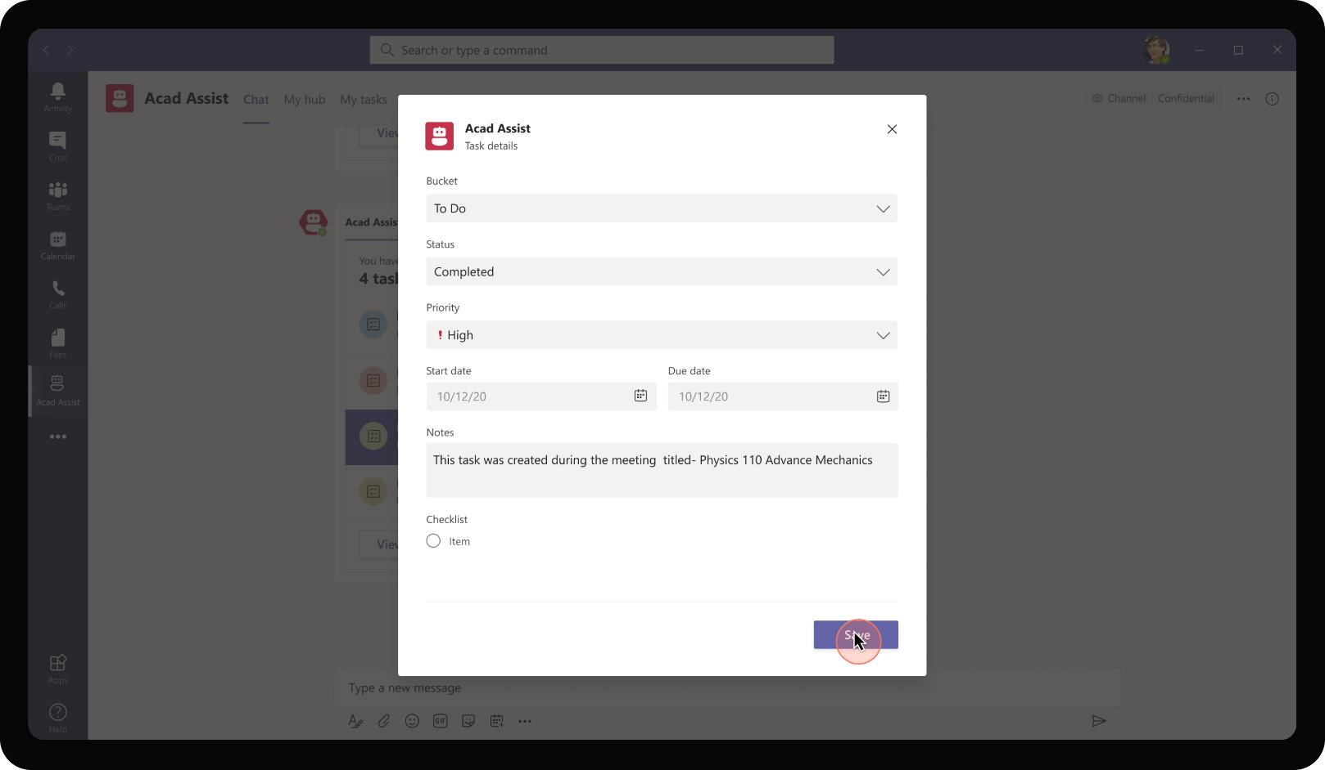
Education – Academics Assistant
The notes are automatically generated to provide Daniel additional context on the source of task creation. Daniel marks the task as completed and saves using the task module.

Slide 65
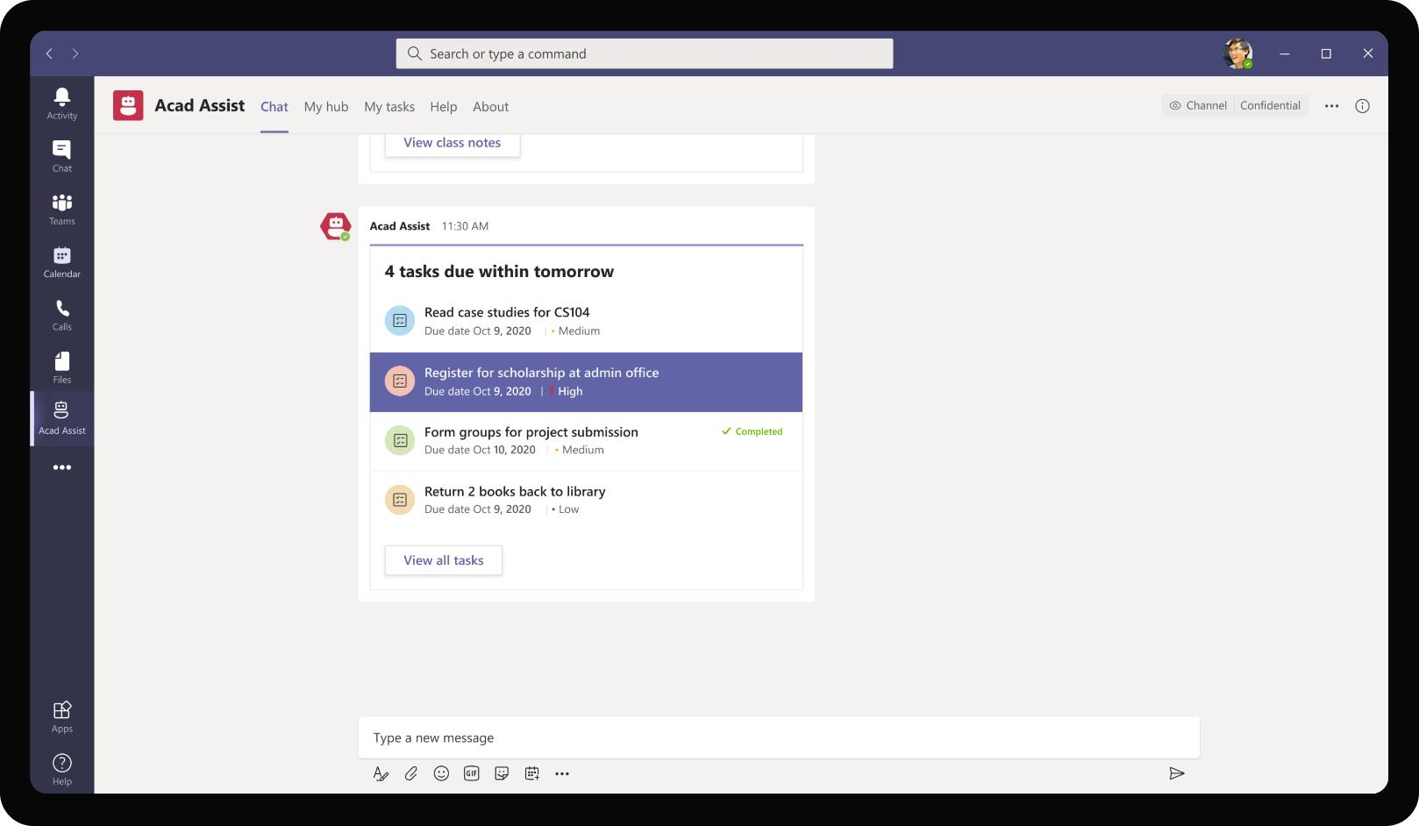
Education – Academics Assistant
The card with list of tasks updates to show the respective task as completed allowing Daniel to focus on other items in the list.

Slide 66
Solution Highlights – Best Practices
Education – Academics Assistant
Key Solution Design Considerations
Platform Extension Points
User Experience
Personal Scoped App The app is a personal scoped app because the experience, classes, tasks need to be customized for each student. Each student will have their own experience of student hub
Personal scoped Tab is ideal for showcasing the largely visual hub for the students. Especially since students will be using mobile to interact with the app on the go, it is required that app is highly visual and less conversational
The bot in personal scope is mostly utilized from the perspective of alerting and reminding the students on upcoming deadlines, status changes, announcements allowing the student to take action on those.
Meetings extensibility comes into play here as an in-meeting tab where students can take notes during a class and take action items, to do lists from the class. These are usually done in a paper-based manner and can be automated to certain extent
Card refreshes are used to update the card status instead of sending multiple different cards about the same request. This ensures that readability is easier, and app does not spam with multiple cards for updates.
List cards are used for providing reminders about upcoming tasks, assignment deadlines. With list cards, it is easy to know the pending tasks in a glance with option to delve deep into each of them
Proactive Messages are sent at intervals based on announcements, reminders and alerts to each student. Students should ideally get an experience to configure their preferences around these scheduled alerts.
Graph API
The app utilizes OneNote Graph APIs to retrieve class notebook, create pages and sections and insert notes created by each student during the meetings.
To do tasks APIs are used to create tasks in the To Do list for the signed in user.
Assignments Graph API are used to list the assignments sorted by due date.

Slide 67
Solution Architecture
Education – Academics Assistant
Azure Subscription
AAD
External Systems
SSO & User IDs
Create pages, insert content
Bot / Task Module / ME
Student info, class information
OneNote Class Notebook
Student
MS Teams
Bot Registration
Acad Assist
App Service
Message broadcasts
Create Tasks
To Do Tasks
GET / POST Scores
GET Student details
Broadcast service
Gamification Database
Student Database
GET course details
Course Database

Slide 68
Event Finder
Education Book of Dreams

Slide 69
Scenario Vision
Student
Context
Daniela is a student at Contoso university looking to share her knowledge and passion in the field of data science with her fellow batch mates. She is also intent on starting a thriving community of data science enthusiasts in the university
She wants to conduct a beginner level workshop on data science to understand the interest level and proceed to form a community from the interested students attending the workshop
Current State
Daniela updates information about the event in a mail or Power Point deck. She forwards it to all students in the university or to mailers. She also does a post on campus notice board.
Students receive multiple e-mails on various open events irrespective of their preferences. They read through all of them and shortlist the ones they are interested in.
Interested students reach out to Daniela or sign up on Daniela's form
Daniela receives all event registrations over e-mail or as a form response.
For all the registered participants, Daniela sends the pre-read materials and other setup instructions as attachments over email blast.
Students with questions on the pre-read or setup instructions, reach out to Daniela over email again. Multiple students might have same question and Daniela spends time explaining the same answer with multiple attendees
After the event is closed for registrations, Daniela has to manually remove her notice board posting or send an email blast announcing registration closure
Future State
Daniela uses Teams app to create a new event entity and provides details about her event, timelines, and content that will be covered.
As Daniela publishes the event entity, it is available for everyone in the university to view and apply. Daniela may also choose the event to be visible for students of certain classes / teams.
Students can then filter events based on their skills and preferences and apply for events that interests them
As students apply for Daniela’s events, she can keep track of registrations and close registrations if required directly from the app
As students register for the event, they get added to a Team automatically for further collaboration, communication from Daniela in a scale manner
Students who register for the event also get to meet other students who have similar interests and passion. The app builds healthy communities
- Points of Friction

Slide 70
Daniela Mandera, Student
Daniela is a student at Contoso university. She is an advanced student in Computer Science and Statistics majors. She is passionate about Data science and is looking to conduct data science workshops in her university for extra credits.

Slide 71
Daniela gets introduced to the app’s functionality and features as she installs the app for herself.

Slide 72
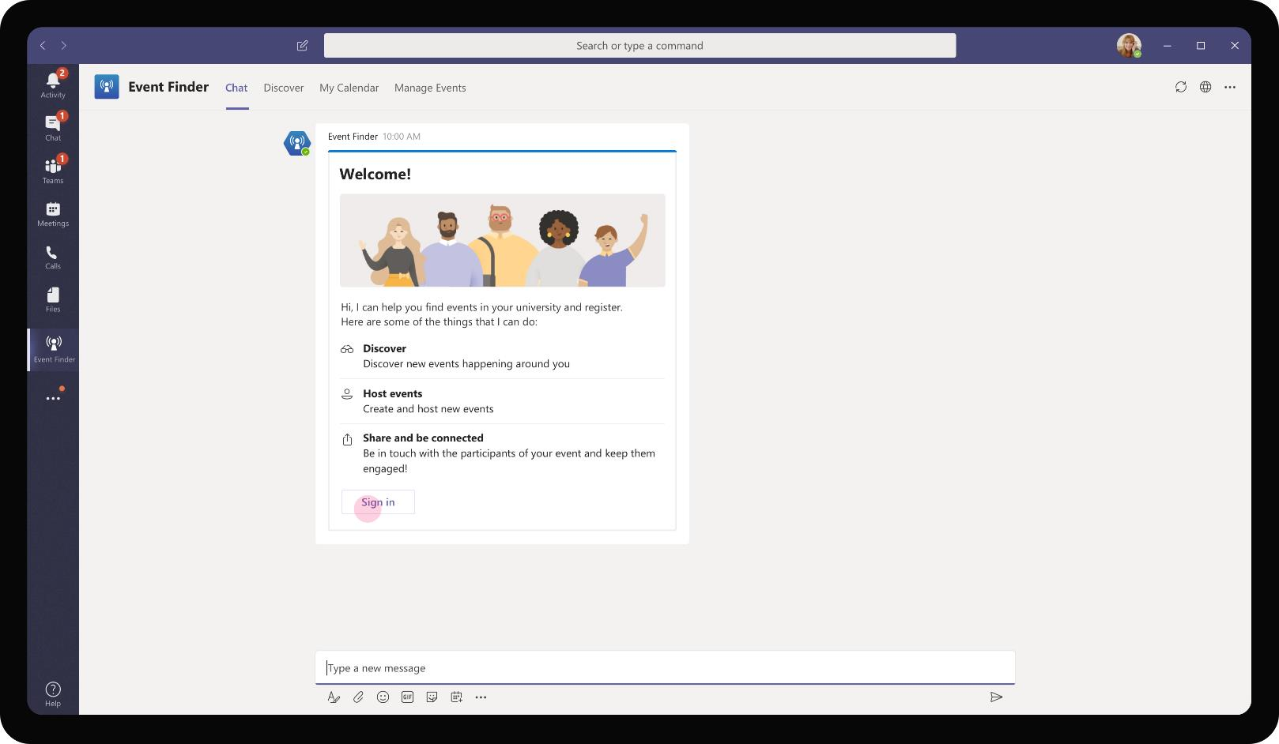
Education – Event Finder
The app sends a welcome message on installation introducing the various actions that a user can perform using the app.

Slide 73
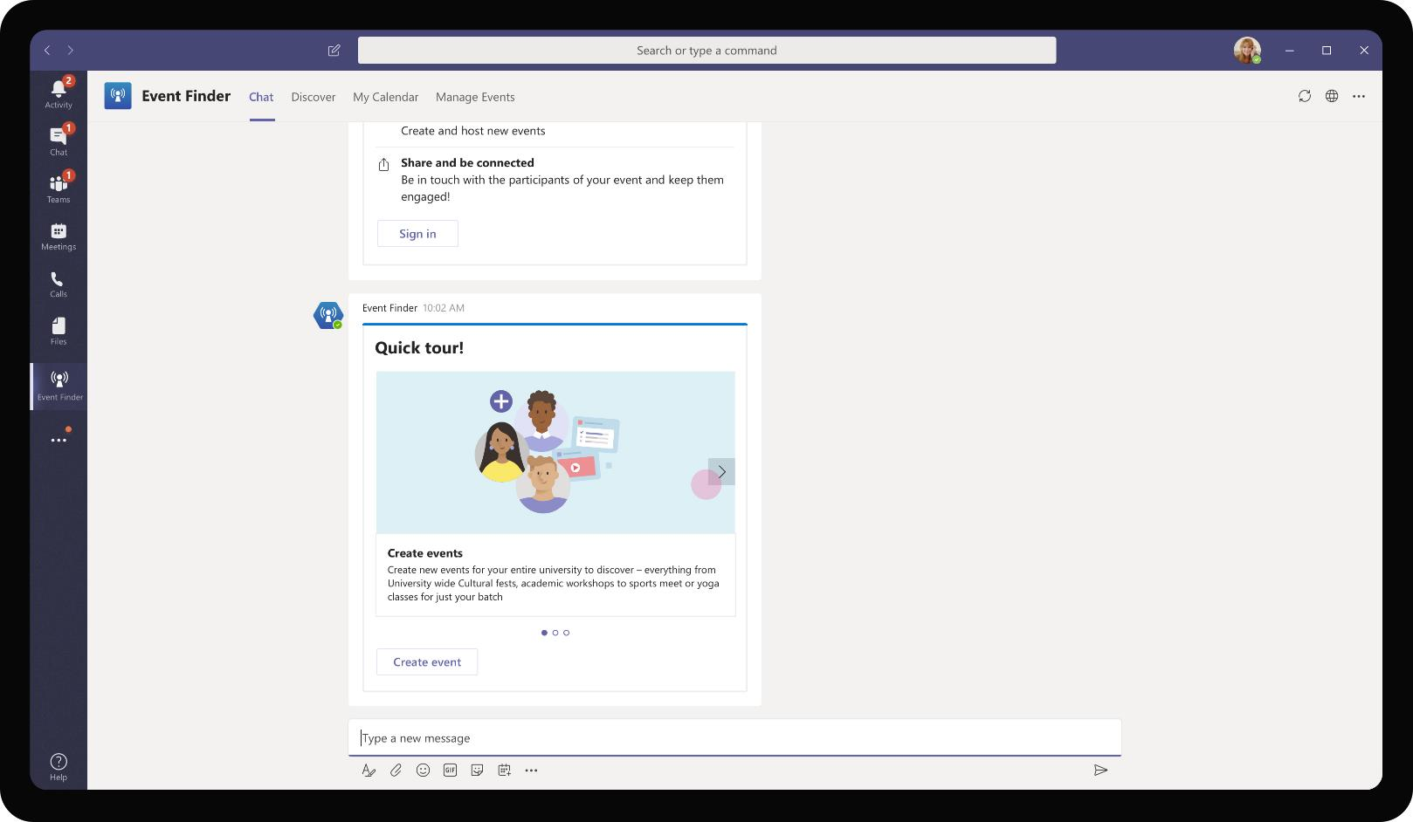
Education – Event Finder
Students can create their own events within the campus and invite their fellow college mates to attend the event

Slide 74
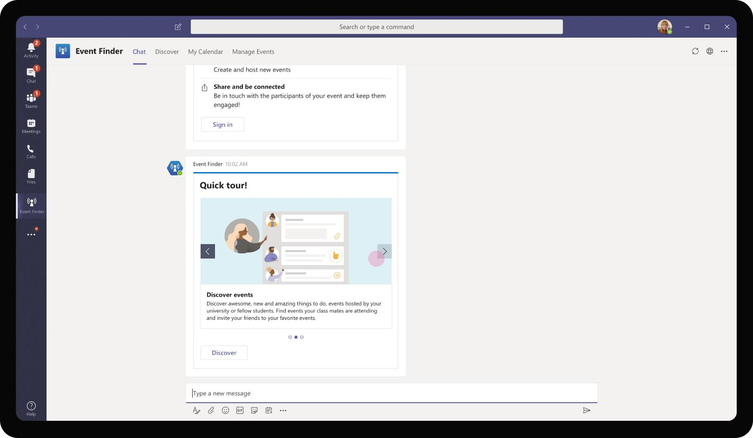
Education – Event Finder
Students part of Contoso university can search for events happening at any point in the campus and choose to join the event as a participant or as part of organizing committee depending on nature of the event.

Slide 75
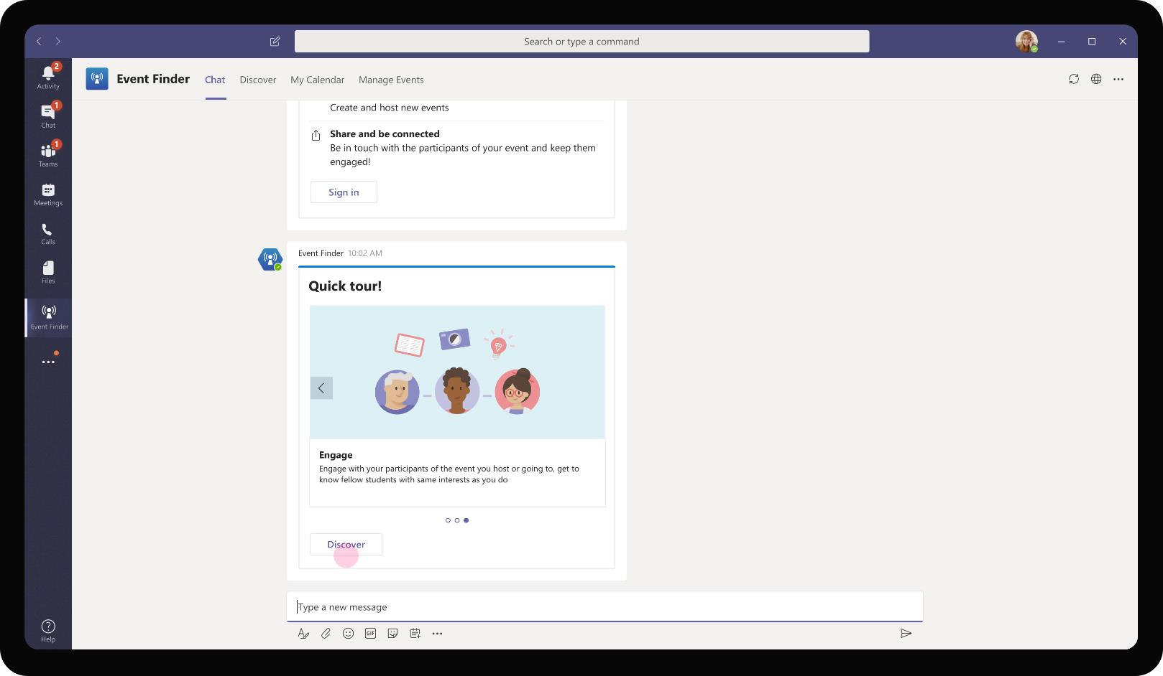
Education – Event Finder
Once students join an event, they can start engaging with other students who have joined as well. They can grow their network and connections within the campus by getting together with likeminded students with similar interests and likes

Slide 76
As Daniela intends to host an event, she chooses to create a new event providing its specifics and broadcasts it for others to view and register

Slide 77
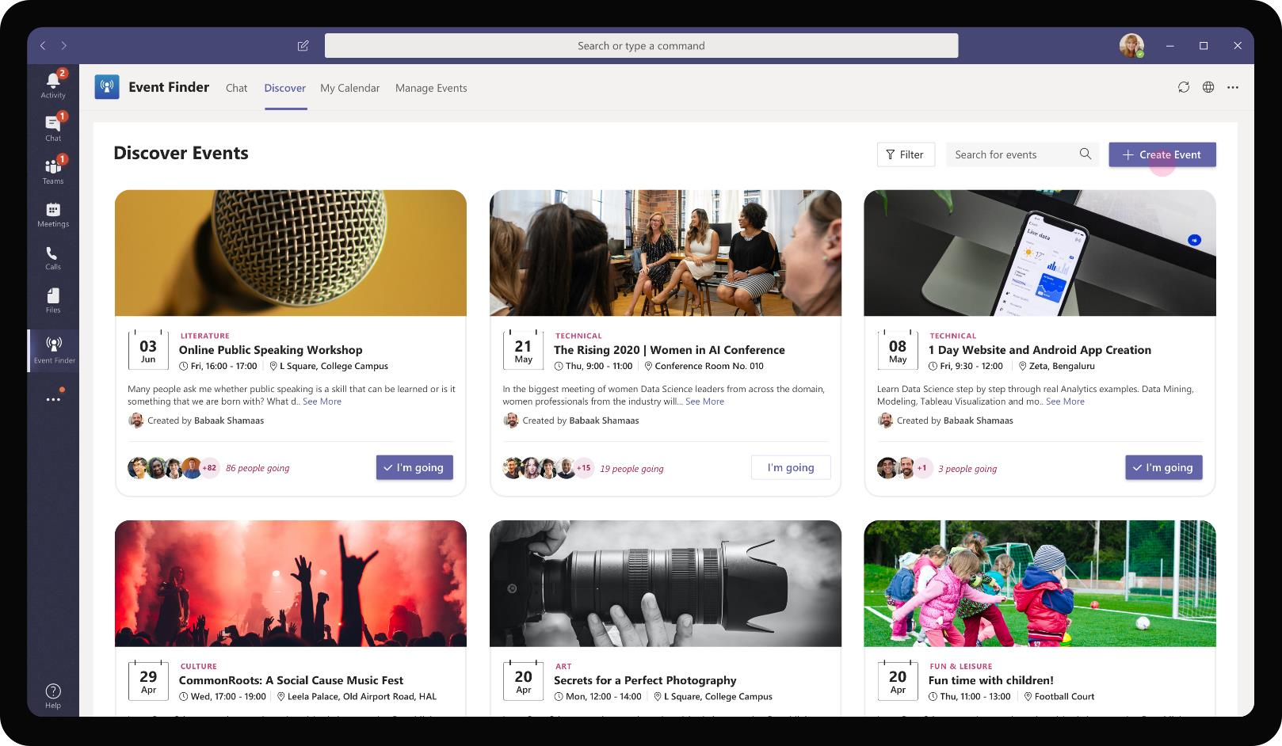
Education – Event Finder
Daniela can create new events by clicking on the ‘Create Event’ button in the Discover tab. It is placed prominently and is persistent way that Daniela can come back to whenever she has a need to host an event for her batchmates or class members

Slide 78
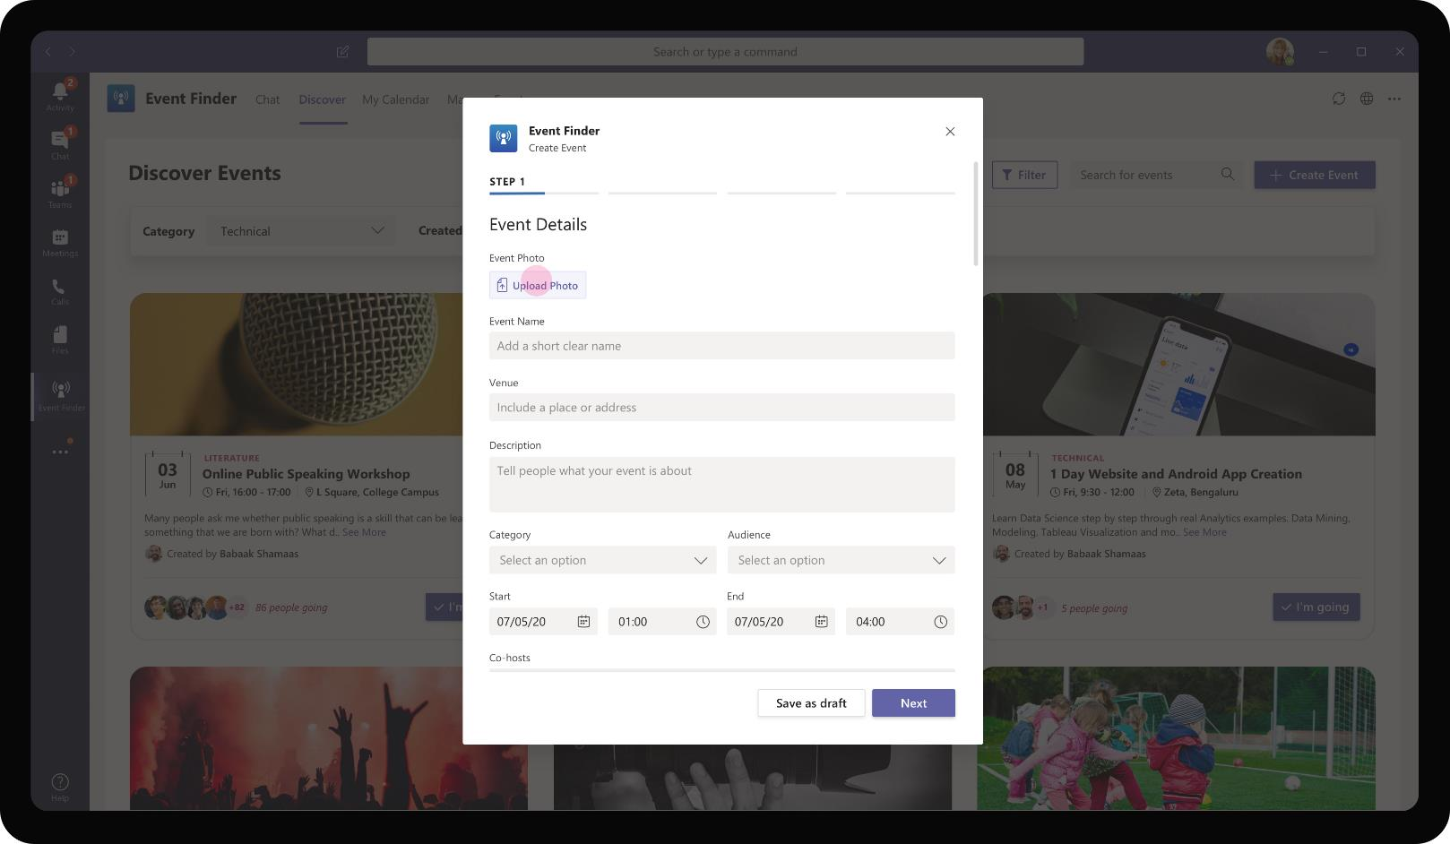
Education – Event Finder
A task module opens with an Event creation wizard that shows step by step input form for collecting details around the event.

Slide 79
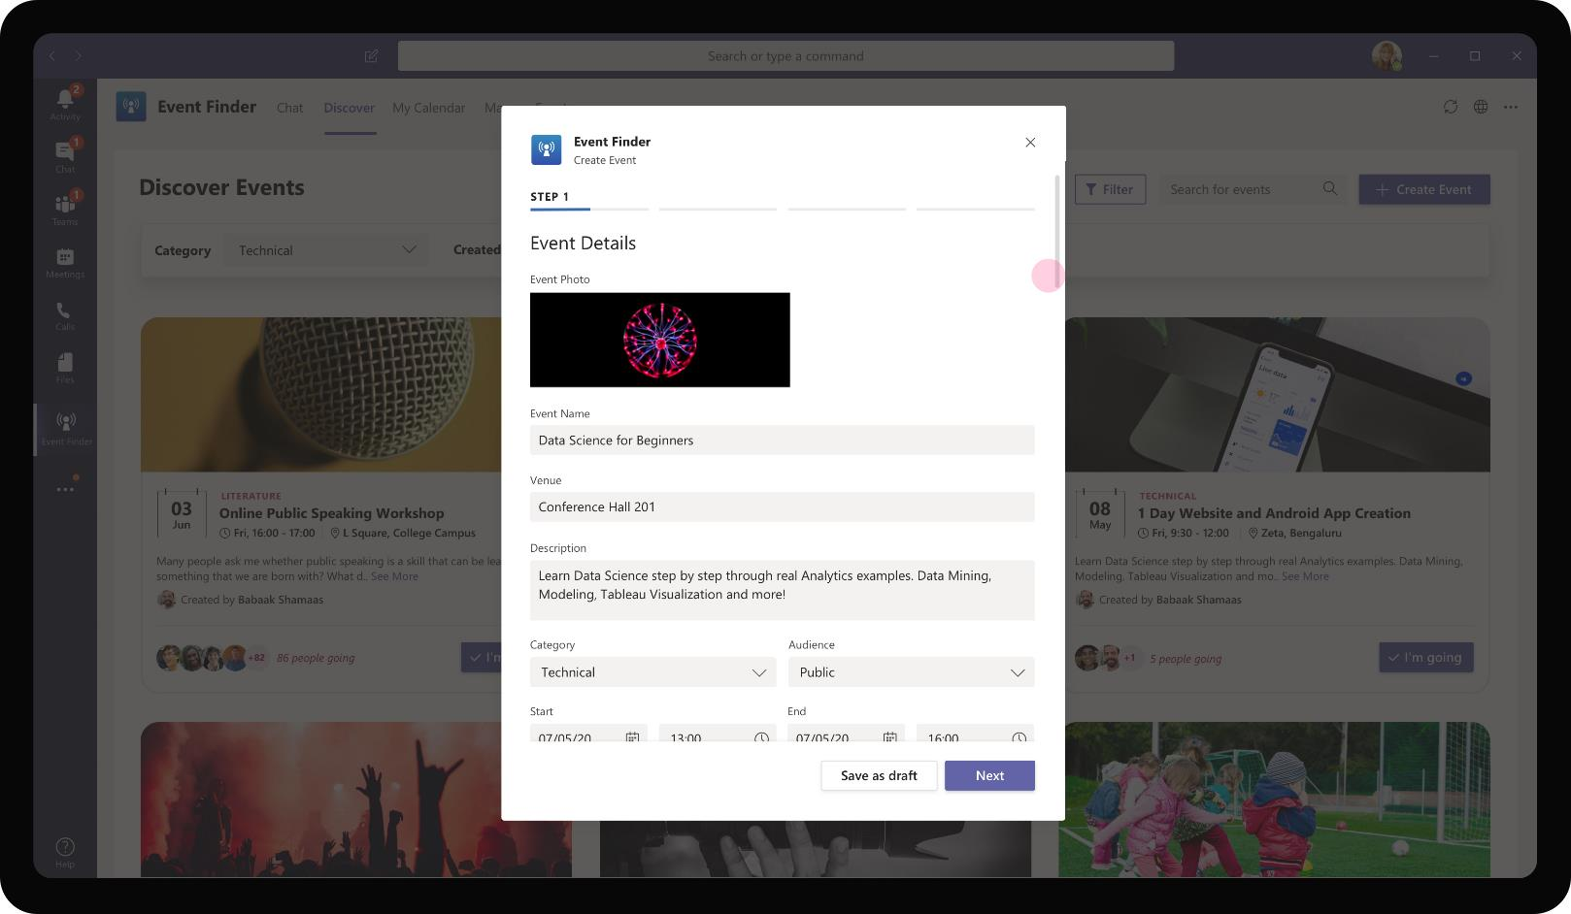
Education – Event Finder
Daniela enters information about the event in each step. She marks the event as Technical under category and chooses her Audience as public. An event with public audience is visible across entire university for anyone to register and attend.

Slide 80
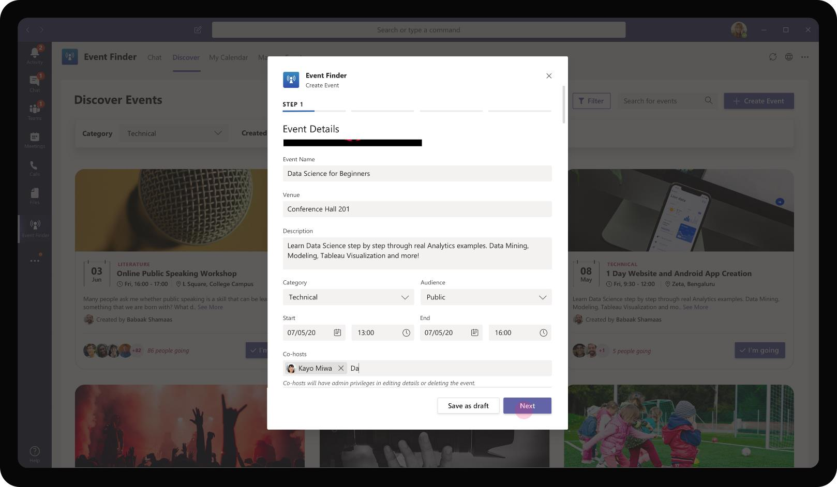
Education – Event Finder
She proceeds to choose co-hosts for the event. These members will have access privileges to the event that include viewing registration details, editing and cancelling the event.

Slide 81
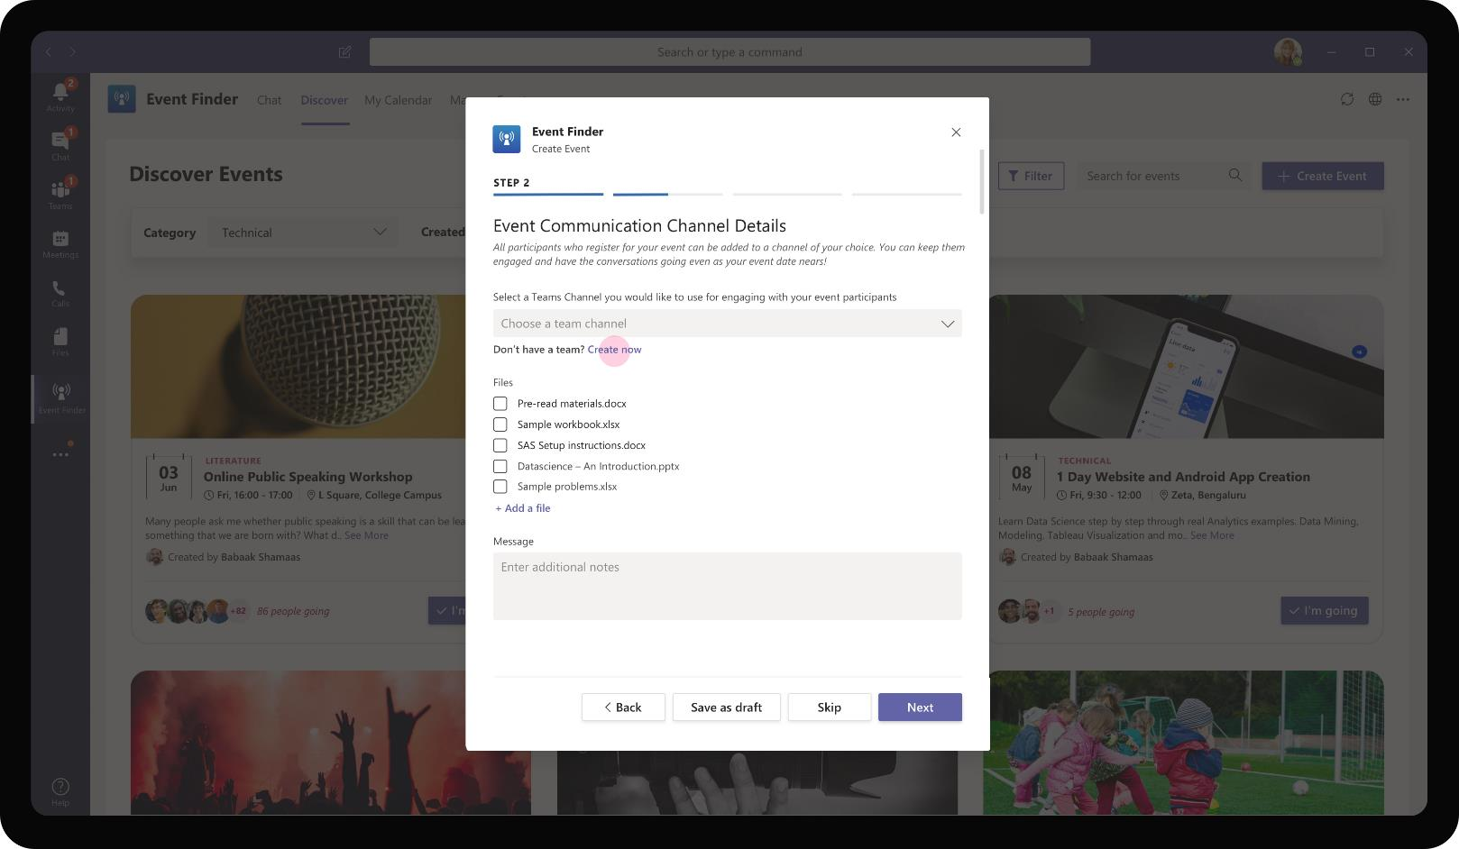
Education – Event Finder
As an optional step, Daniela may choose to associate an event with a Team. When this is chosen, all members who register for the event are brought inside a Team automatically for further communication and information sharing

Slide 82
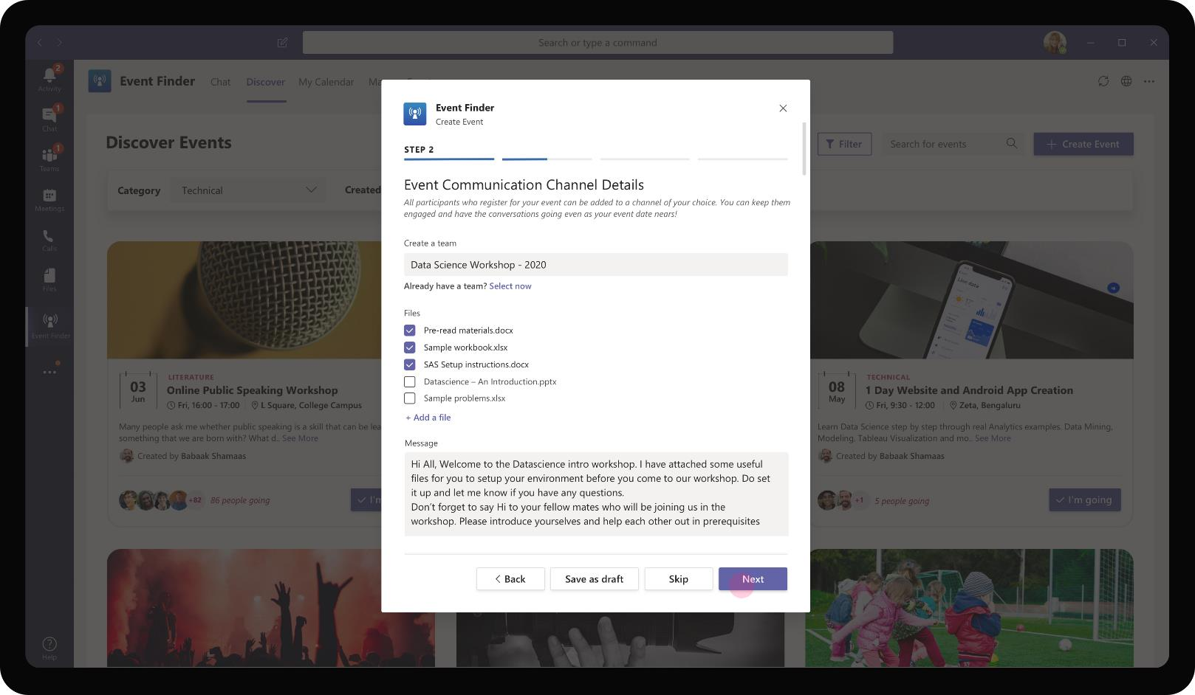
Education – Event Finder
In addition to adding attendees to the Team / channel, Daniela can also pick and choose files that need to be added to the Team and a welcome message to be displayed in the channel.

Slide 83
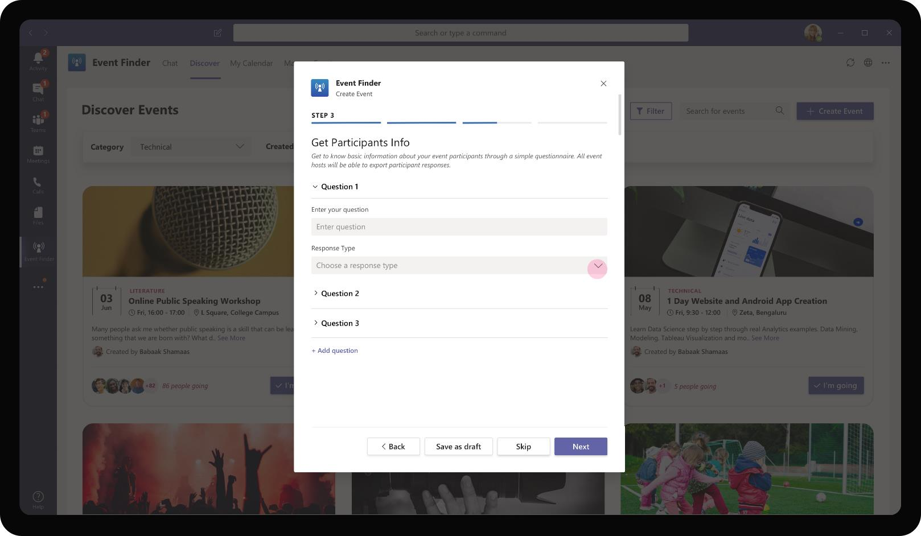
Education – Event Finder
Most event registrations have customary questions that ask the users who wish to register. The app provides an option for Daniela to customize and ask these questions to students who wish to register for her events.

Slide 84

Education – Event Finder
Daniela wishes to know the experience level of students who wish to attend her events so that she can fine tune her content based on the audience skill gap.

Slide 85

Education – Event Finder
She also receives from her attendees on their expectations upfront. This is chosen as a small text box where attendees will be able to mention their expectations as a free flowing text.

Slide 86

Education – Event Finder
Finally the app provides a preview of her event details for her to confirm before creating the event.

Slide 87
As Daniela creates the event, it gets published for everyone in the university to discover. Interested students can check the event details and register within the app

Slide 88

Education – Event Finder
The app allows filtering the events by category…

Slide 89

Education – Event Finder
The app allows filtering the events by category, person who created the event…

Slide 90

Education – Event Finder
The app allows filtering the events by category, person who created the event, and based on popularity. It even shows students who have registered for an event encouraging others to register as well.

Slide 91

Reta Taylor, Statistics Student
Reta is a statistics student who is interested in getting into the career of big data analysis and data science. She has done her own preparation but feels it would be helpful for her to join a study group or entry level crash course

Slide 92
Reta Taylor is keen on finding events that will further her career aspirations. She finds a data science event organized in her university and decides to enroll.

Slide 93

Education – Event Finder
Reta uses the Discover tab in the app to check out the events that are currently happening or scheduled to happen in her campus. She finds that there is a beginner level data science workshop that would be a good fit for her.

Slide 94

Education – Event Finder
On expressing interest to join, the app pops open a task module with a couple of questions for Reta to fill. She provides her input to the questions and clicks on register

Slide 95

Education – Event Finder
A calendar invite is automatically added to Reta’s calendar for the event she registered. It also mentions that Reta will be added to a Team / channel as part of workshop prep.

Slide 96
As participants registrations come through, the app adds the attendees to a Team chosen by Daniela where she can collaborate and provide further communication to attendees

Slide 97

Education – Event Finder
The app automatically adds members to the Team created by Daniela for the specific event. Bot added to the team posts the welcome message designated by Daniela.

Slide 98

Education – Event Finder
Pre-read materials and software setup files posted by Daniela are available for attendees to go through, ask questions with the community if required. In addition to the actual event, participants get to meet and be a part of an active data science learner's community.

Slide 99

Education – Event Finder
Daniela can continue to engage with the participants and make sure they are all prepped for the workshop and have read the pre-read materials required to understand workshop content.

Slide 100
As Daniela receives enough attendees to fill up her workshop capacity, she can go through list of events that she owns and close registrations

Slide 101

Education – Event Finder
Manage events tab lists events that Daniela is a host or co-host. She is given a view of participants who have registered for each event.

Slide 102

Education – Event Finder
For each event, the host or co-host has additional privileges to edit the event details, export registration information (containing participant email address and response to the questions

Slide 103
Students get alerts from the app periodically on new events that are added or if certain events are popular in the campus

Slide 104

Education – Event Finder
The app provides a digest of events that were newly published and available for them to register. This could be popular events in their campus or events that they have shown prior interest.

Slide 105
Solution Highlights – Best Practices
Education – Event Finder
Key Solution Design Considerations
Platform Extension Points
User Experience
Personal Scoped App The app is defined to be predominantly personal scoped as event discovery (consume) and posting (produce) are individual activities. The collaboration part of the app brings applicants into one team and encourages dialogue and knowledge sharing
Personal Tab – Both Discover and Manage Events are available as personal tabs for a user to discover interesting event based on each student’s interest or passion
Personal Bot – Personal bot caters to each student’s personal preferences and sends digests of new events
Channel Scope (Optional): Although not represented in the earlier screen, the app has potential to have a channel tab with a config page to choose category / type of events. E.g. A Team / channel on a subject can have a channel tab filtered to events happening related to the subject
Proactive Messages are sent to students when new events are added and alerts when an event they have registered for is nearing.
Card refreshes are used to minimize the number of cards sent to the end user and reduce overload on user’s chat window by reducing the number of cards sent for the same event
Digest Cards are used to show event names and summary information for each event. This also serves the purpose of collating all related information (events of the same category) in one unit as opposed to sending a card with event detail
Graph API
Applicant insights information around collaboration can be retrieved using People & Workplace Intelligence Graph API
The app also uses Graph API to create a Team and to retrieve Files.

Slide 106
Solution Architecture
Education – Event Finder
Azure Subscription
AAD
Graph API
Student
(Consumer)
SSO and Reporting org
People insights, Files & User profile
Bot / Task Module / ME
Trigger event search, submission, registrations
MS Teams
Bot Registration
Event Finder
App Service
GET / POST Event Information
Student
(Event Creator – Producer)
Registrations
Files
Events Database

